Slide 1
Lecture 4 – Intro to Deep Learning
Naveh Porat
June 2022

Slide 2
Table of Contents
01
04
Quick ML Brief
Backpropagation Algorithm
02
05
The Neuron
DNN Tips & Tricks
03
06
Feed Forward Neural Network
Why Deep

Slide 3
Quick ML Brief

Slide 4
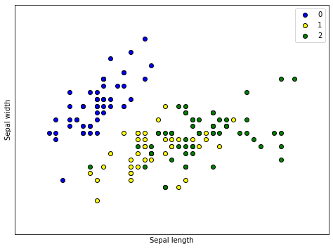
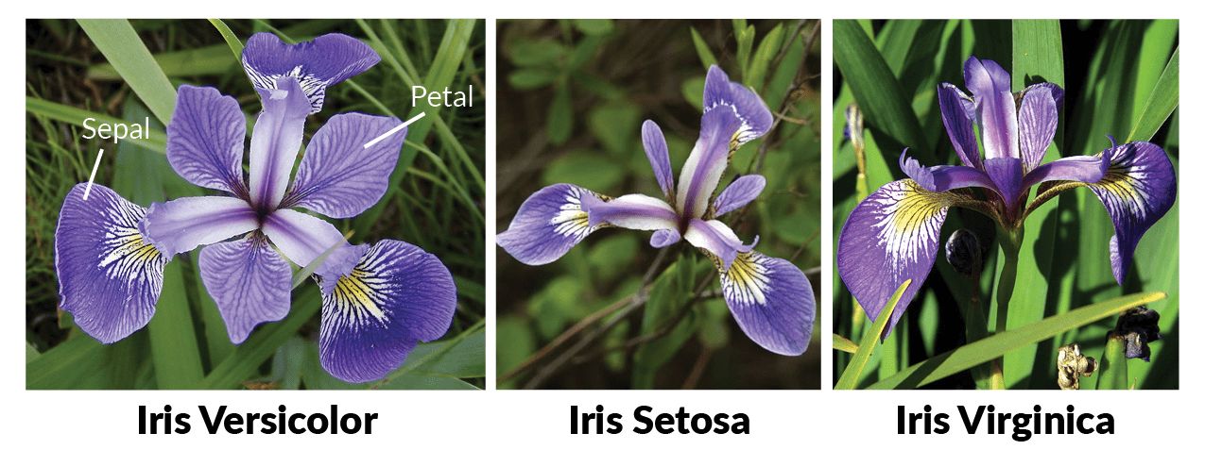
Iris Dataset
In the dataset there a 3 classes of Iris types, and each class contains 50 instances.
Each instance is provided with the width and the length of its petal and its sepal.
The dataset can be found here.

Slide 5
Components of a ML Model
A ML model can be breaked down into 5 main parts:
The data representation.
The model architecture.
The model’s loss\objective.
Training algorithm.
Inference method.

Slide 6

Components of a ML Model – Data Representation
We want to classify Iris flowers. What data do we provide the model?
Petal Length/Width
Color
Picture
What format is the data inputed?
1, 2, 5
0.1, 3.3
A, B, C

Slide 7
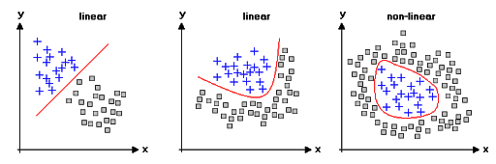
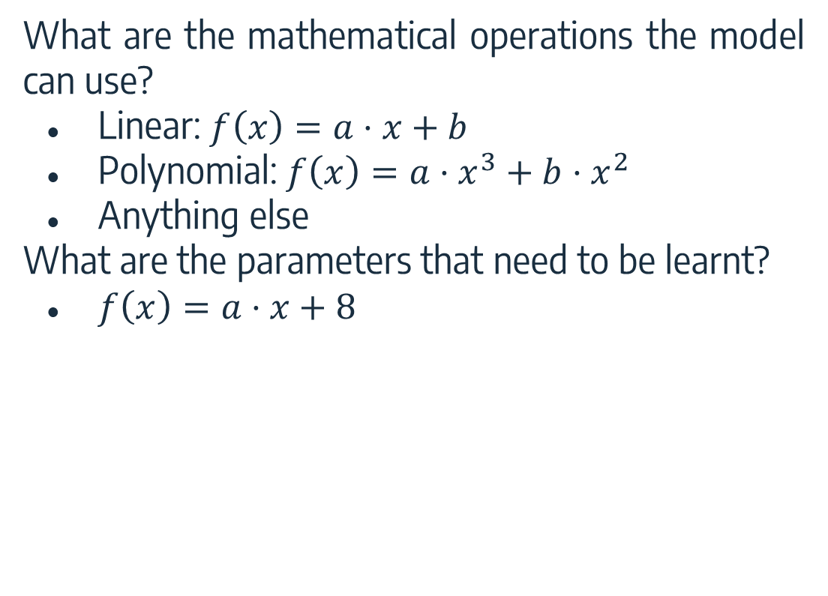
Components of a ML Model – Architecture
What are the mathematical operations the model can use?
Linear: $f\left(x\right)=a⋅x+b$
Polynomial: $f\left(x\right)=a⋅x^{3}+b⋅x^{2}$
Anything else
What are the parameters that need to be learnt?
$f\left(x\right)=a⋅x+8$

Slide 8
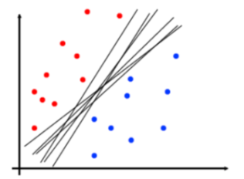
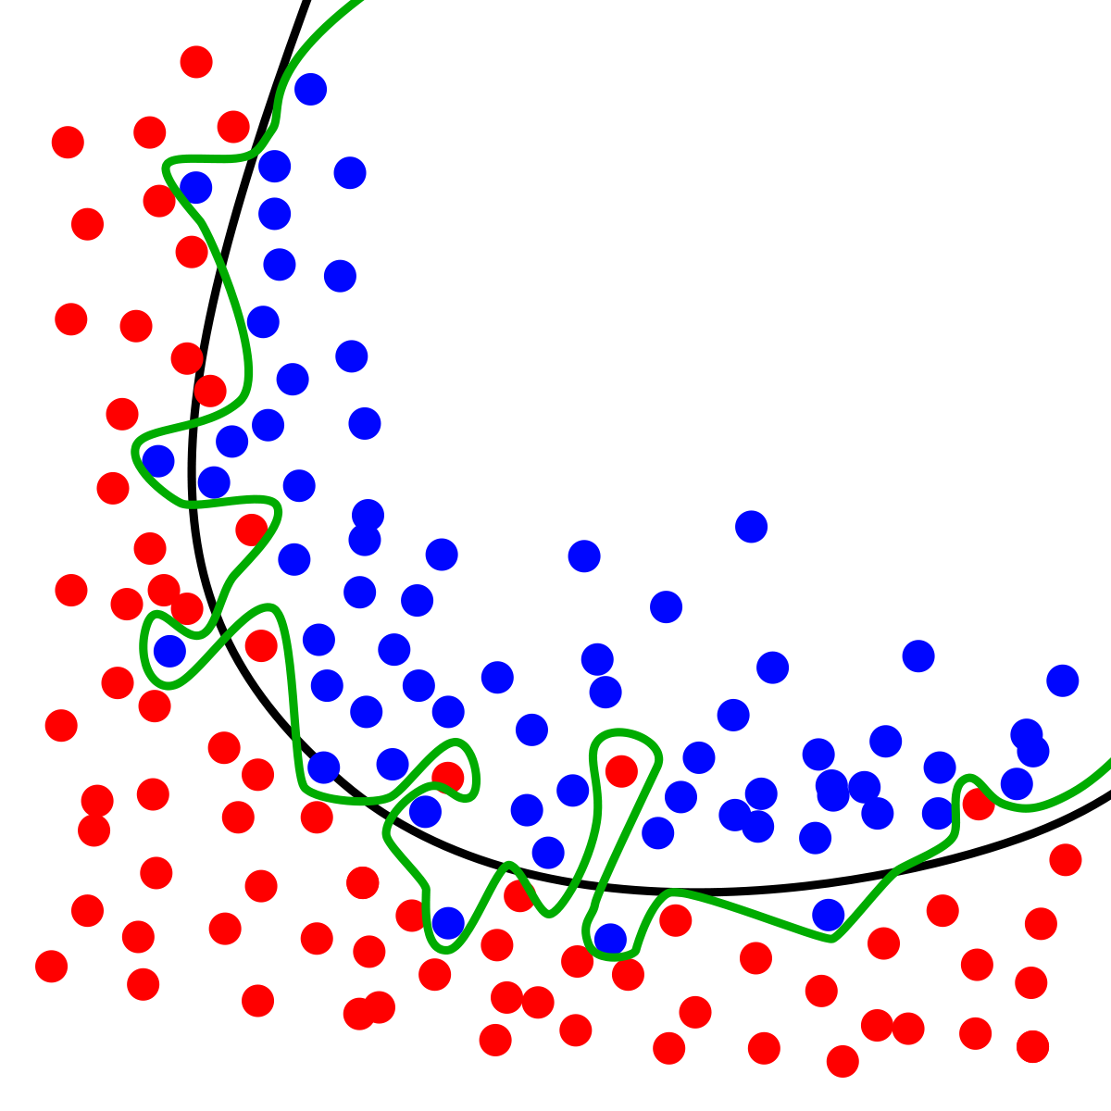
Components of a ML Model – Loss\Objective
How do we define a “good” model? What does the model aim to achieve?
Margin or other properties
Recall vs. Accuracy
Overfitting, complexity

Slide 9
Components of a ML Model – Training Algorithm
How does the model learn the parameters?
Usually, we define a loss function (as we saw), and the model tries to minimize the loss.
There are different algorithms for that.

Slide 10
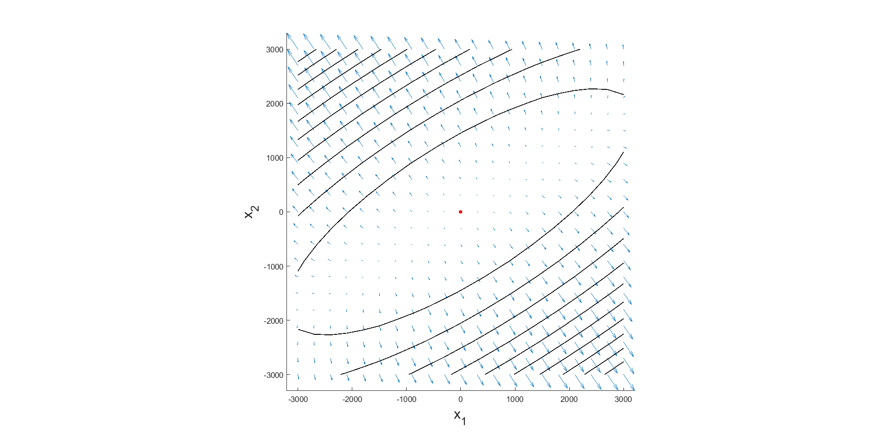
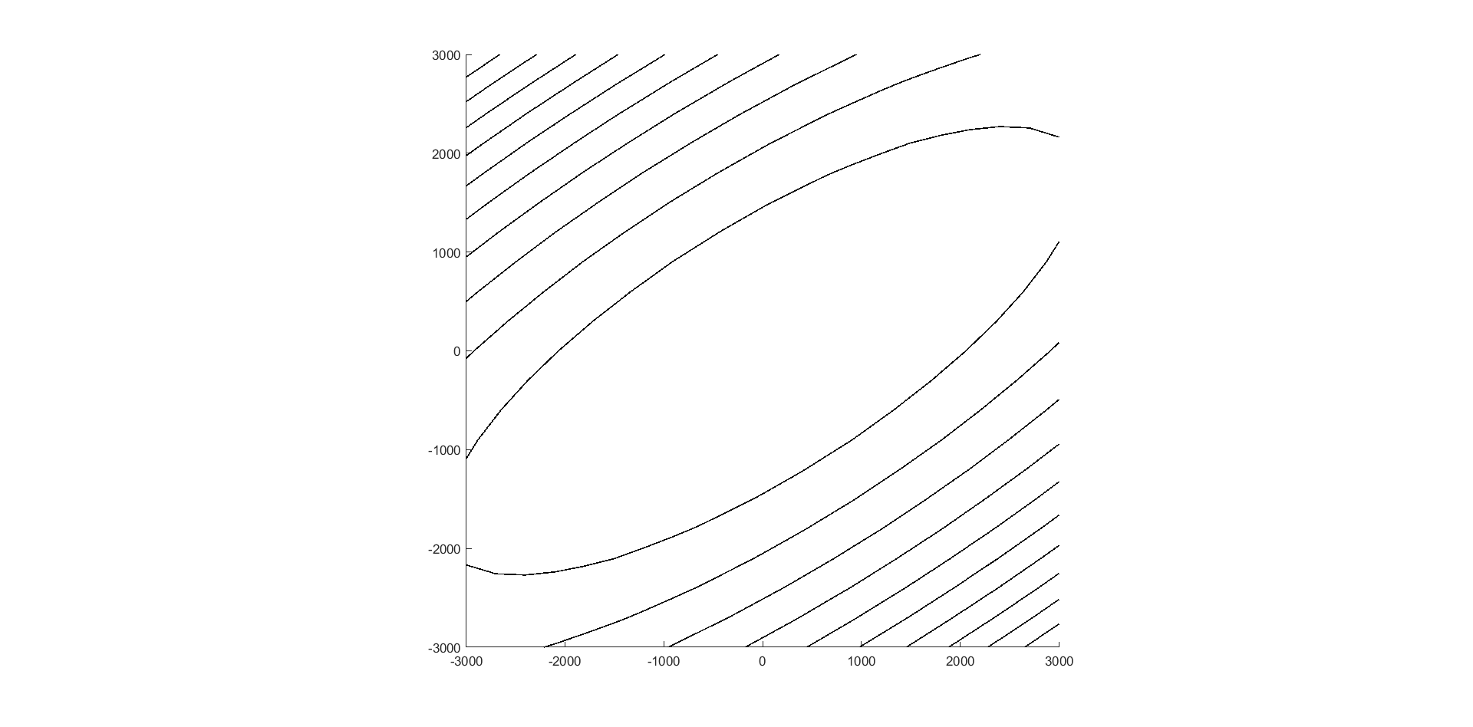
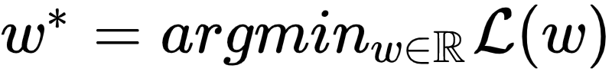
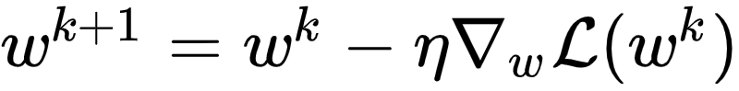


Gradient Descent [~1847]
Goal: find
Idea: gradients point to steepest ascent direction in loss landscape
Descend iteratively:
Guarantee: for small enough, converge to a local minimum
Notes:
In the guarantee, it is under some pretty serious assumptions (derivable, convex, Lipschitz)

Slide 11

Stochastic GD and Friends
Elad Hazan!!

Slide 12

Components of a ML Model – Inference
Once we have the model’s predictions, how do we infer a result?
Usually, we define a loss function (as we saw), and the model tries to minimize the loss.
There are different algorithms for that.
The Model
Cat | Dog
0.08 | 0.92

Slide 13
Intro to DL

Slide 14
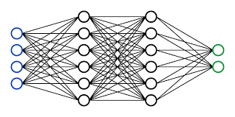
A Brief History of NLP
Where are we on the timeline?
1950 -- ~1990s → Write many rules
1990 -- ~2000 → Corpus-based statistics
2000 -- 2013 → Supervised machine learning
2013 -- today → “Deep Learning!”
2013-2018→ MLP(FFNN)/CNN/RNN
2018 → Transformers (Attention-based models)

Slide 15
A Brief History of NLP
Where are we on the timeline?
1950 -- ~1990s → Write many rules
1990 -- ~2000 → Corpus-based statistics
2000 -- 2013 → Supervised machine learning
2013 -- today → “Deep Learning!”
2013-2018→ MLP(FFNN)/CNN/RNN
2018 → Transformers (Attention-based models)

Slide 16
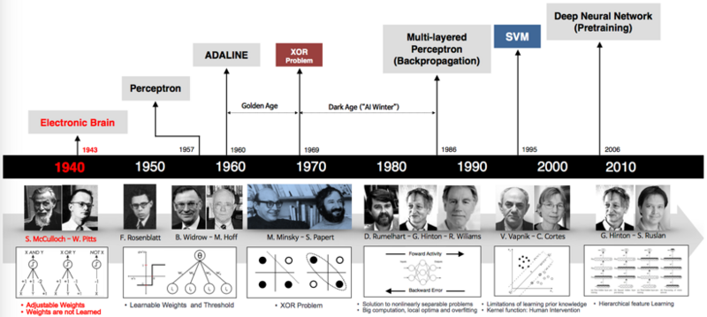
Another Historical Note

Slide 17
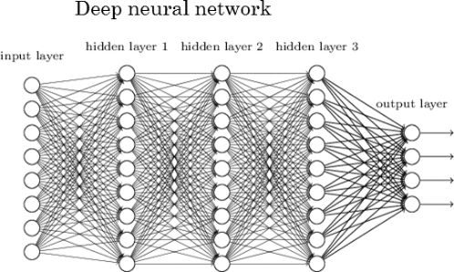
Deep Neural Networks (DNNs)
Neural networks are a type of architecture, i.e. a family of functions.
As before, when learning we search for the best network parameters to minimize the empirical loss.
This is done using some gradient descent variation.

Slide 18

Deep Neural Networks (DNNs)
Neural networks, as the name suggests, are made up of stacked neurons.
Neuron -> Thing the holds a (real) number
This number depends on the example/text you feed it
Has input and computes something w.r.t to input
-> a function

Slide 19
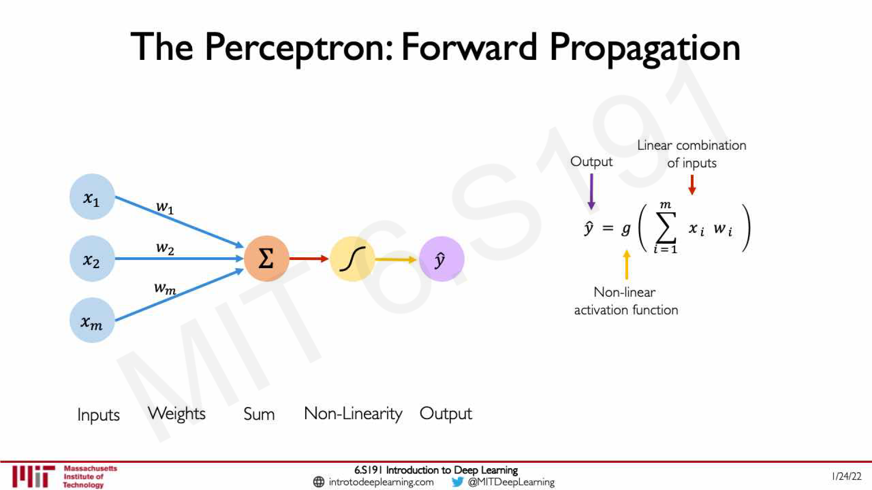

Slide 20
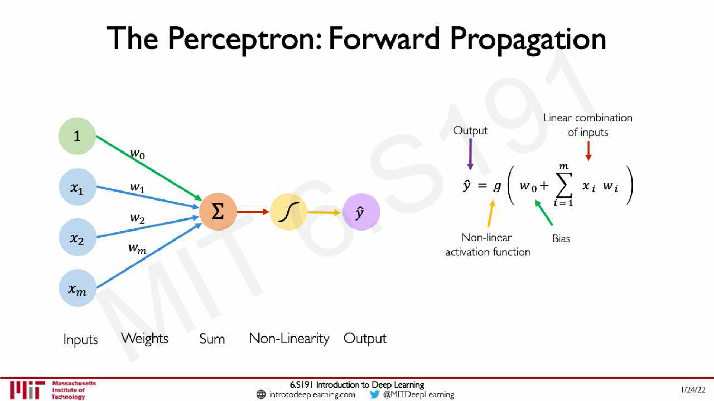

Slide 21
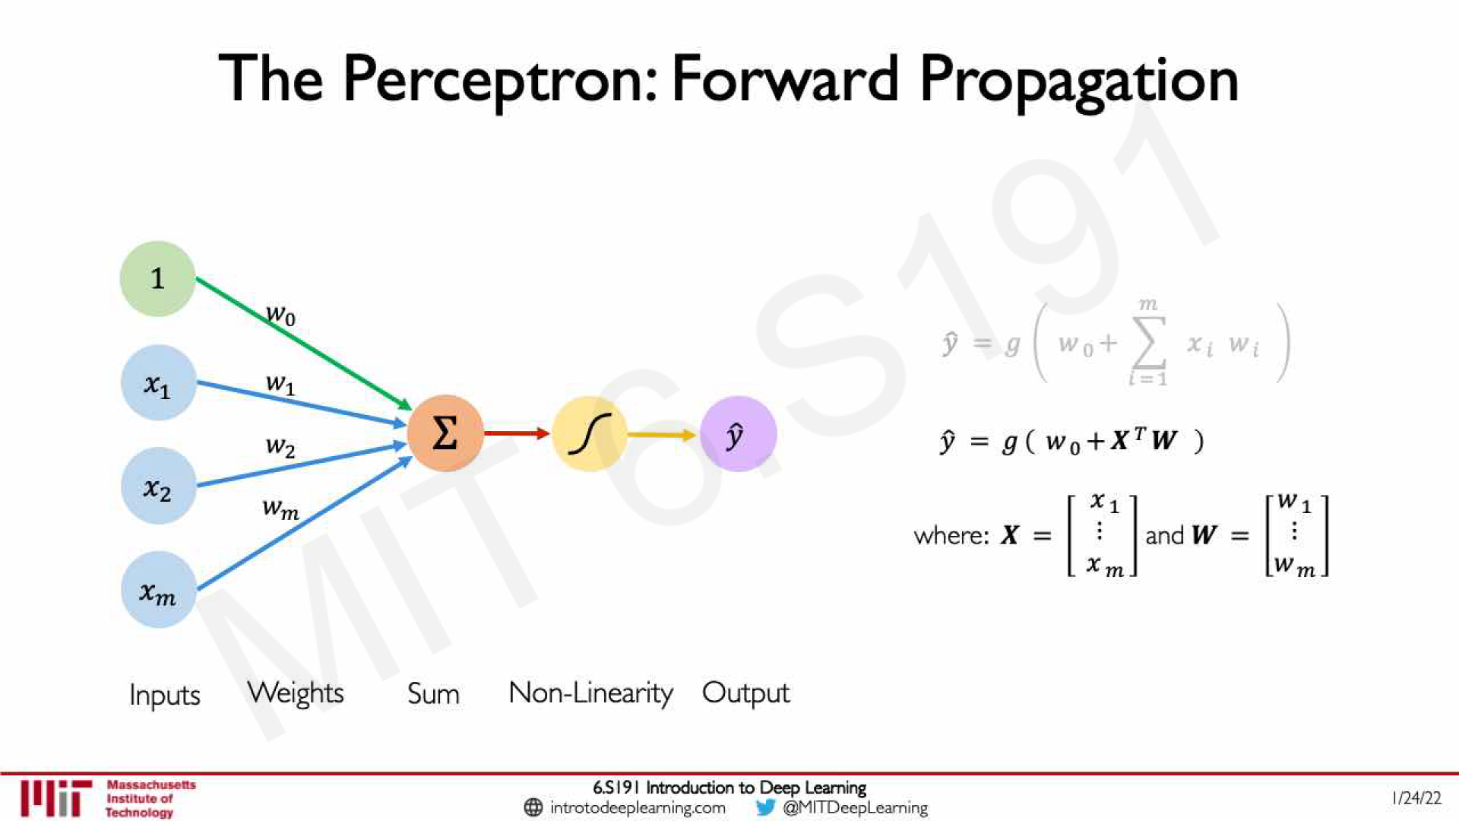

Slide 22
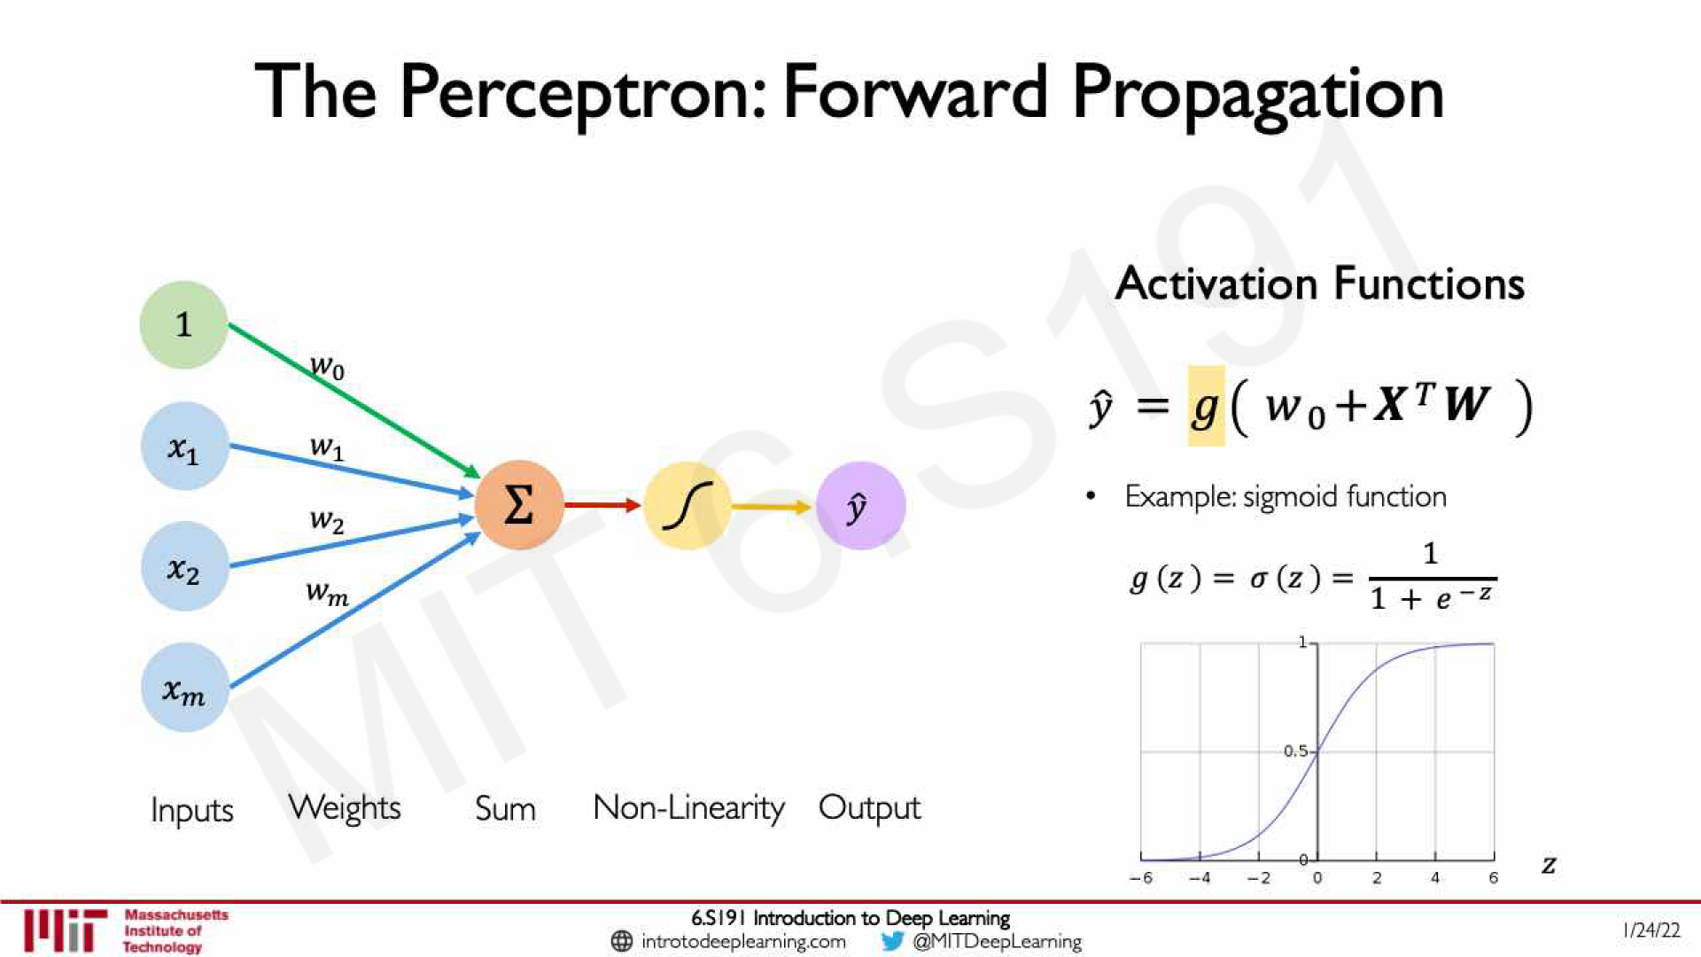

Slide 23
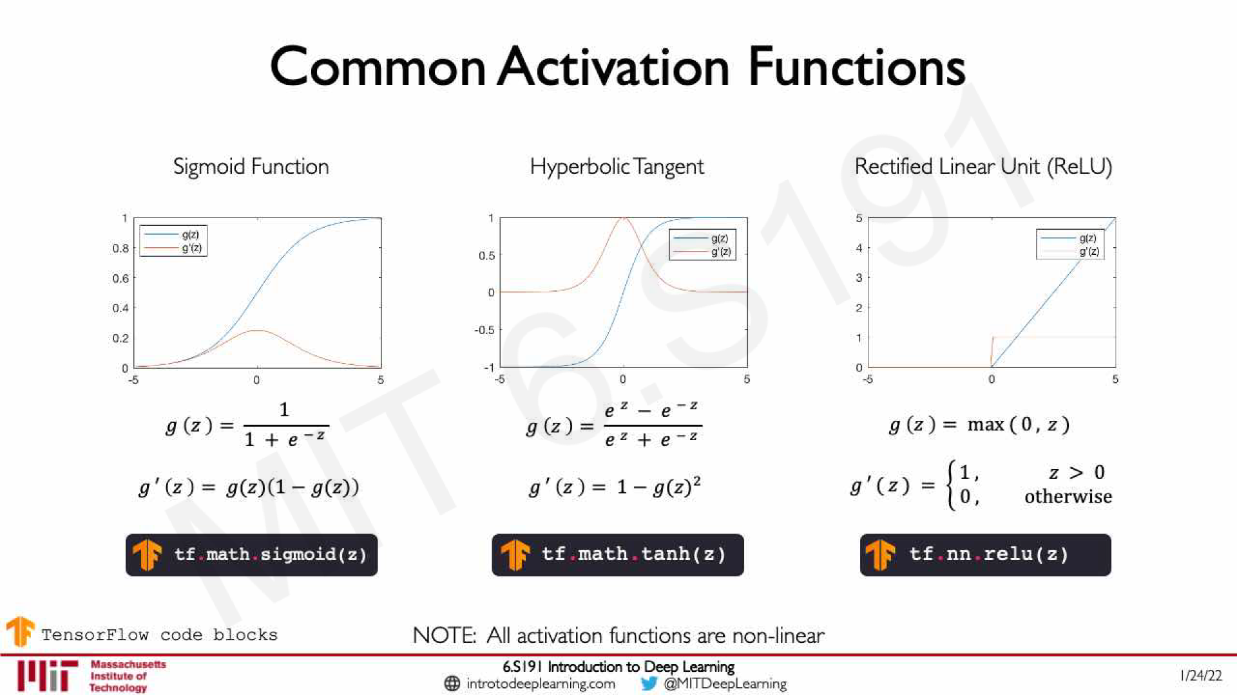

Slide 24
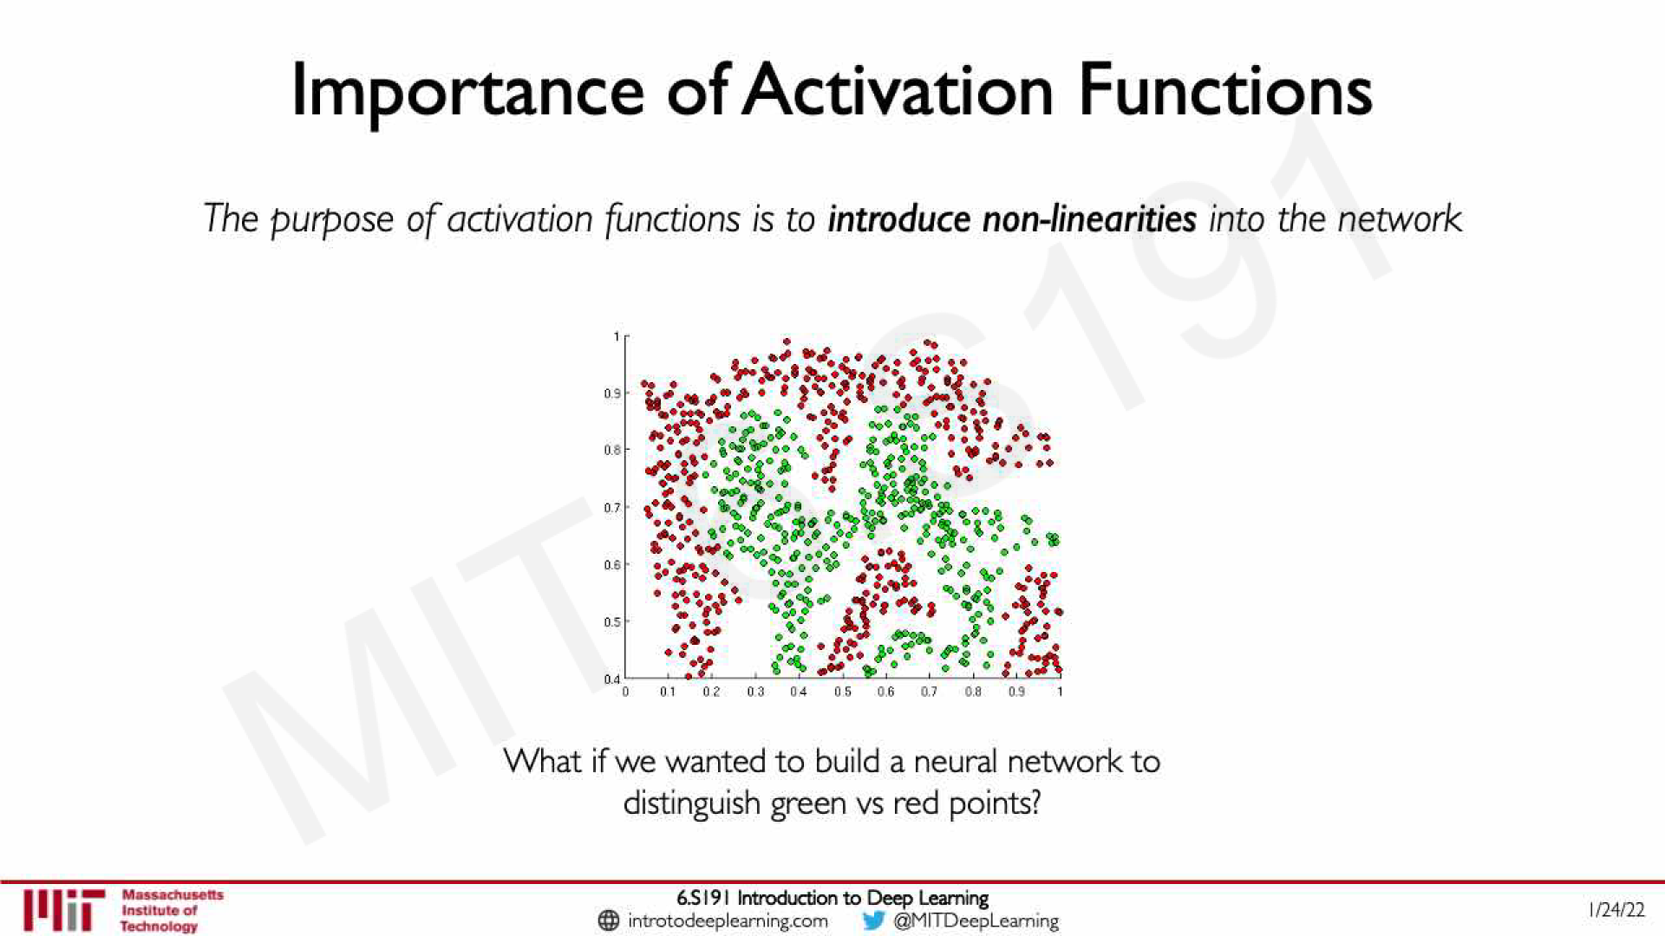

Slide 25
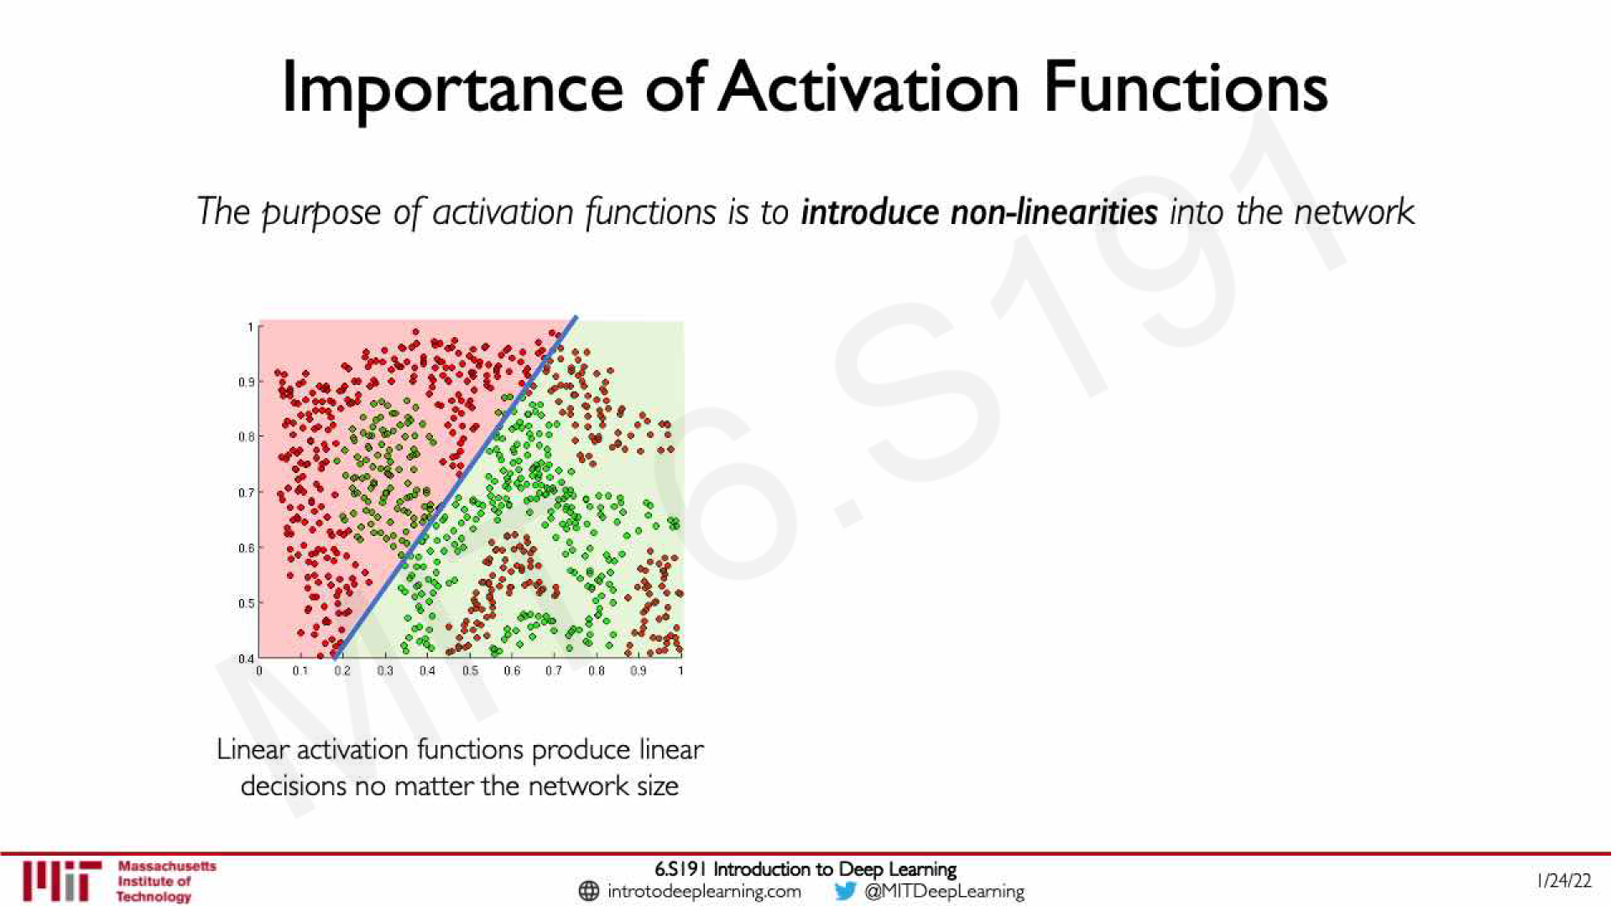

Slide 26
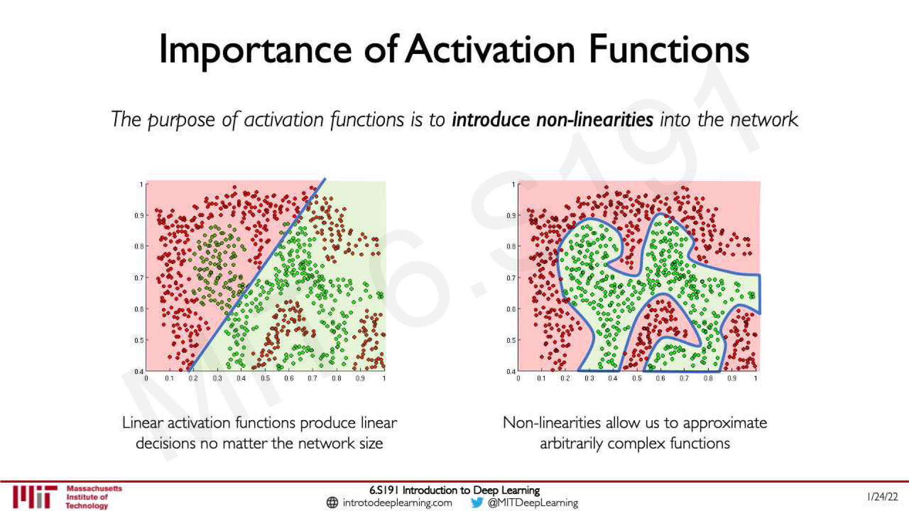

Slide 27
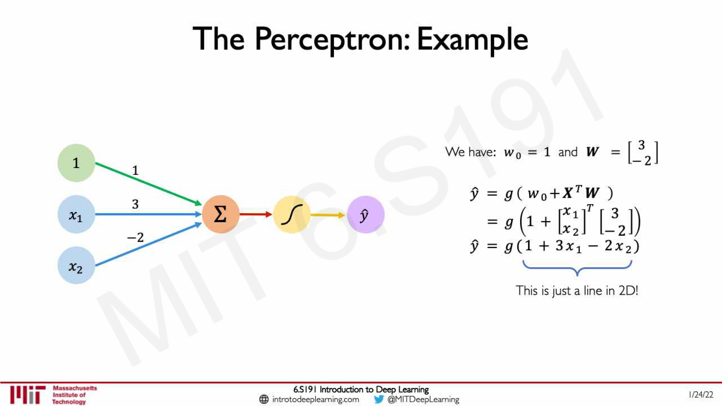

Slide 28
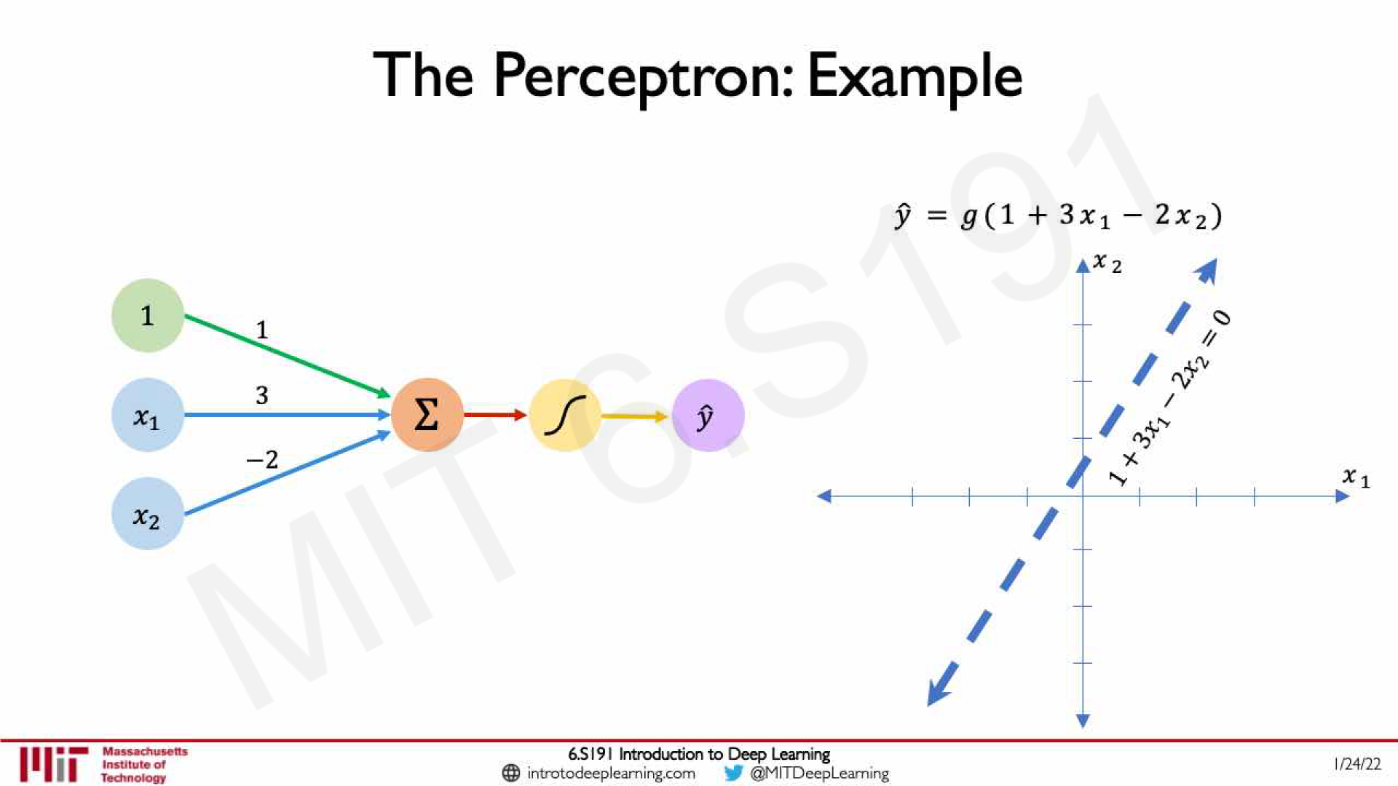

Slide 29
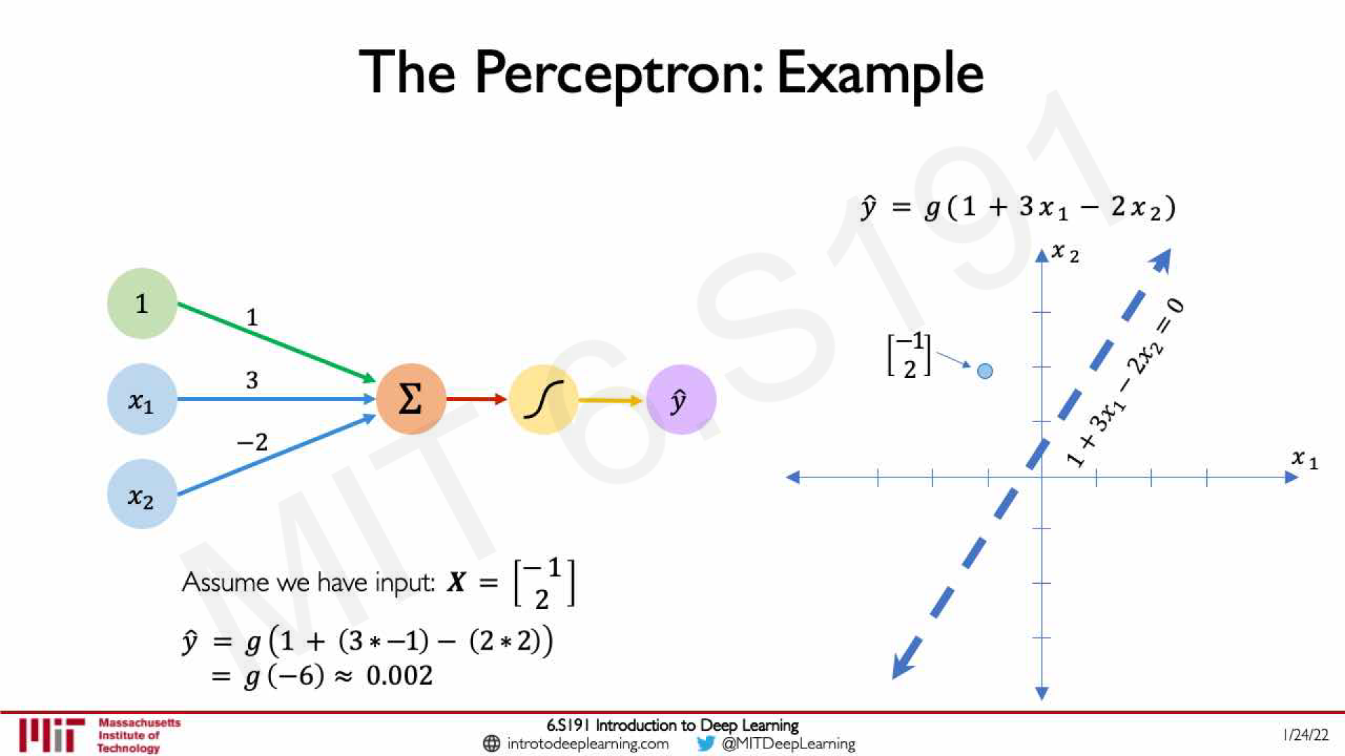

Slide 30
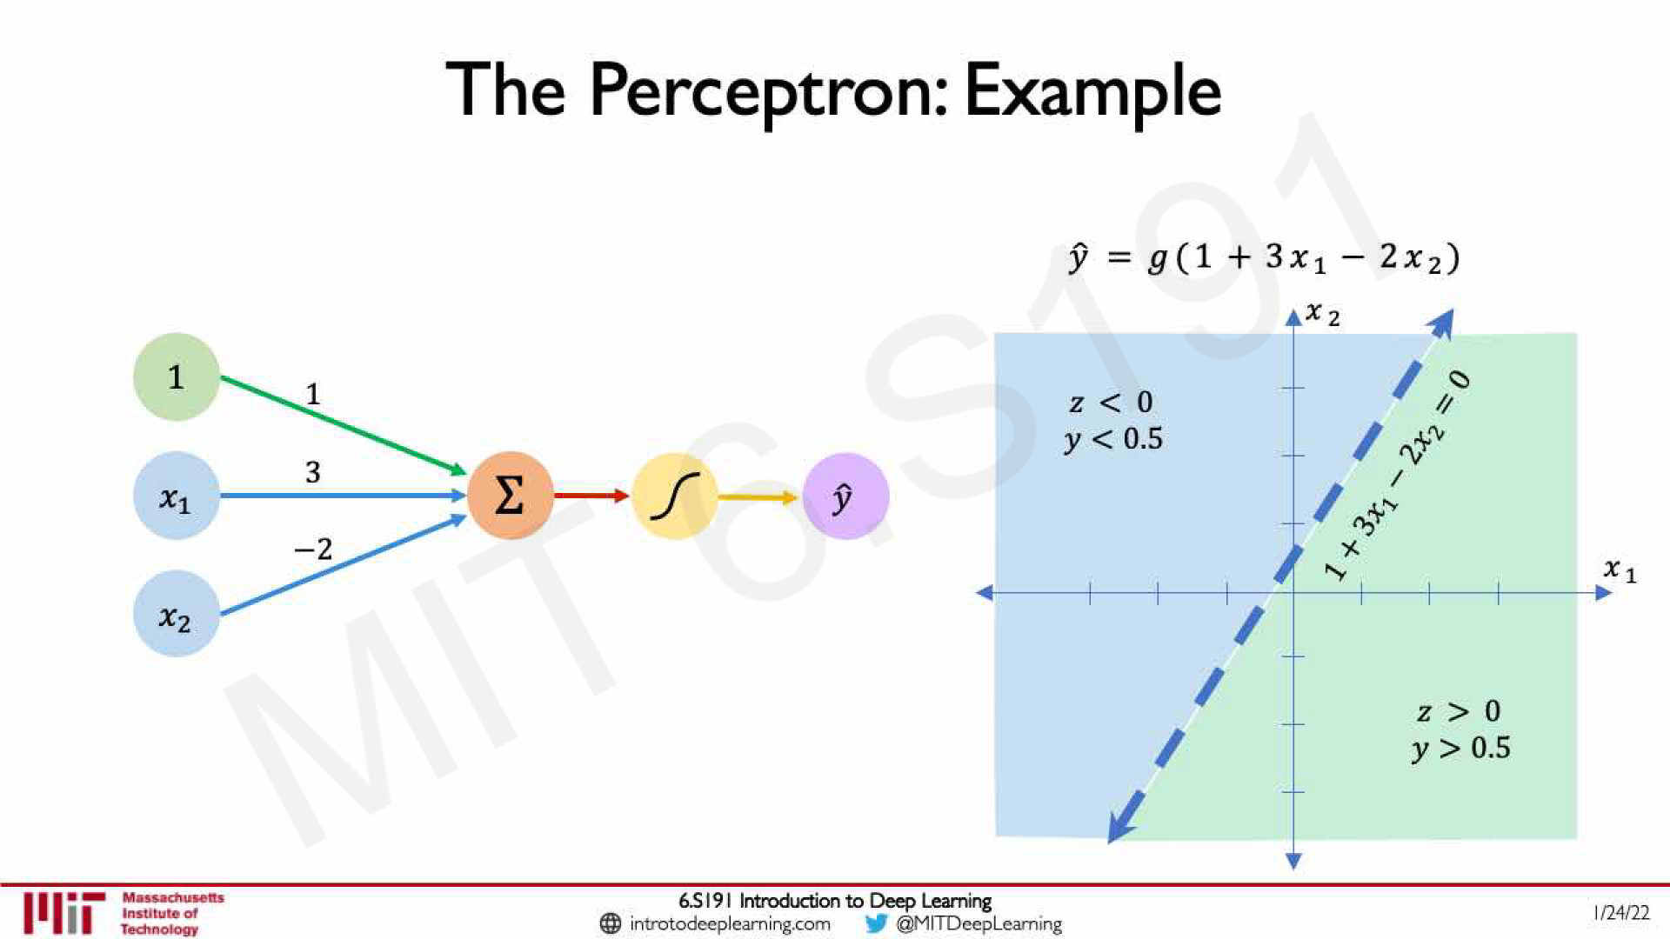

Slide 31
Feed Forward Neural Networks

Slide 32
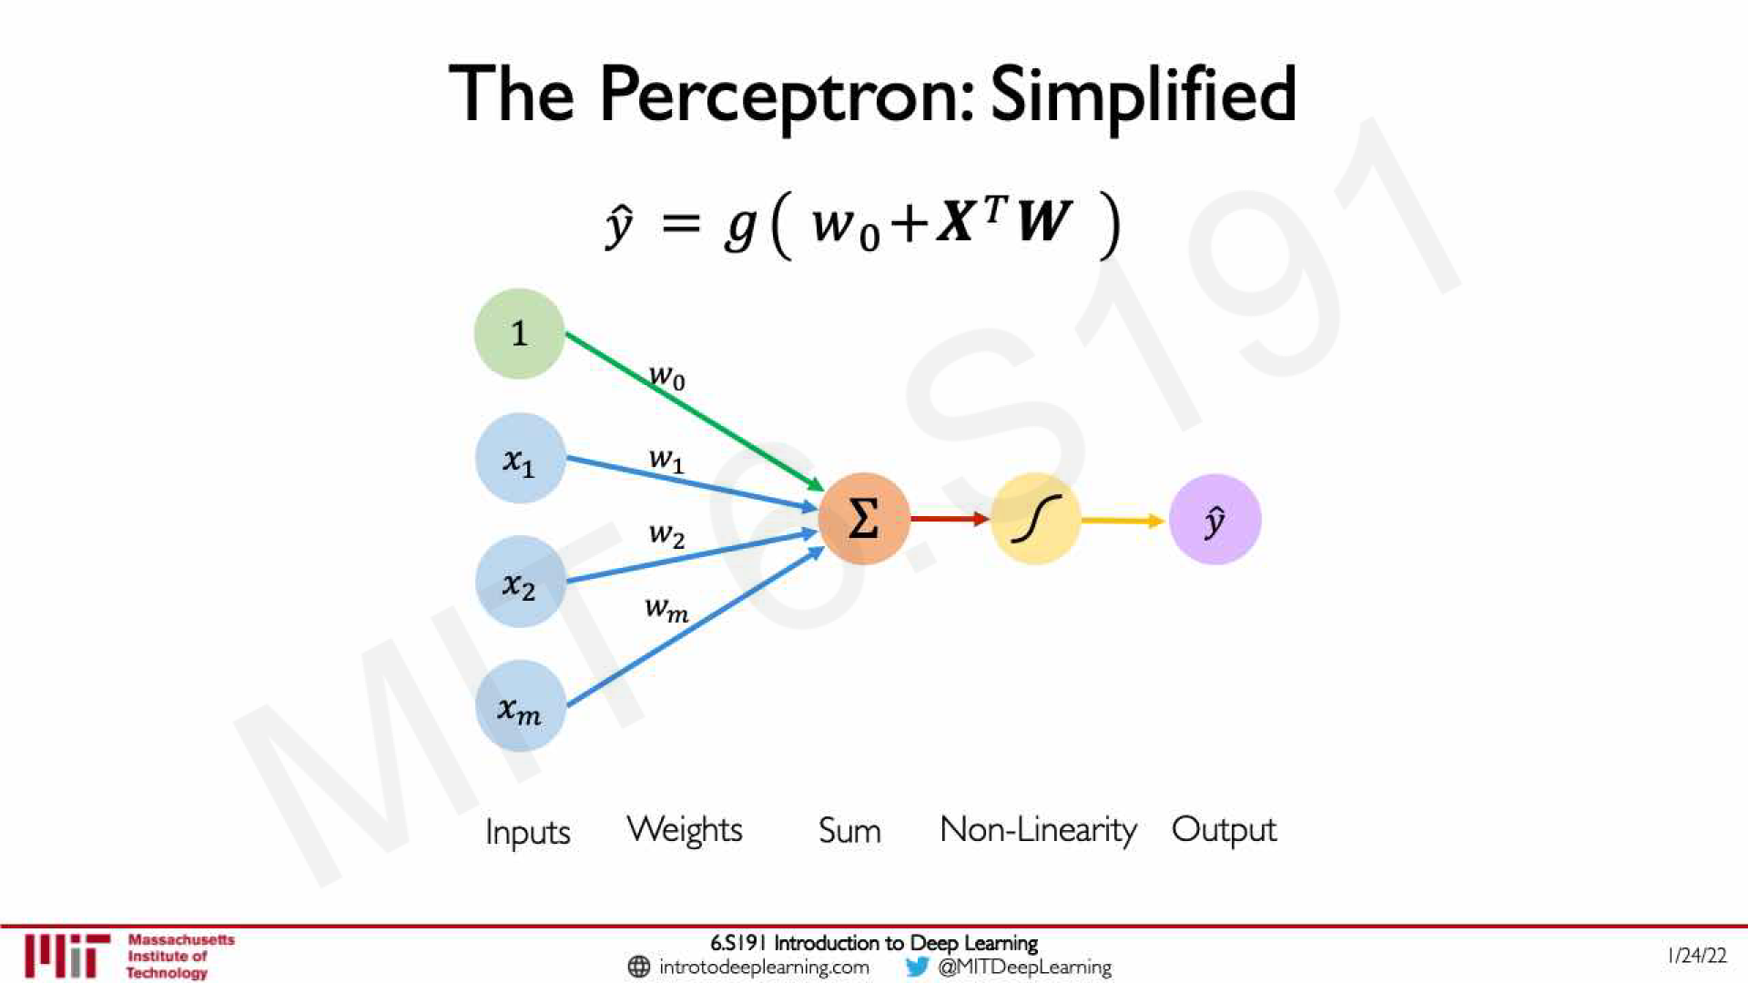

Slide 33
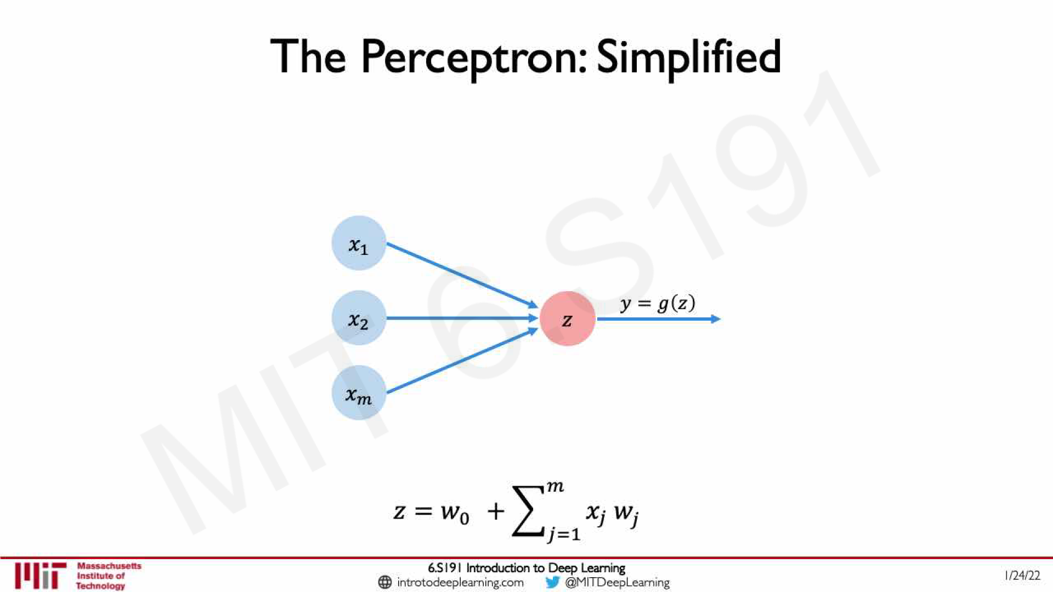

Slide 34
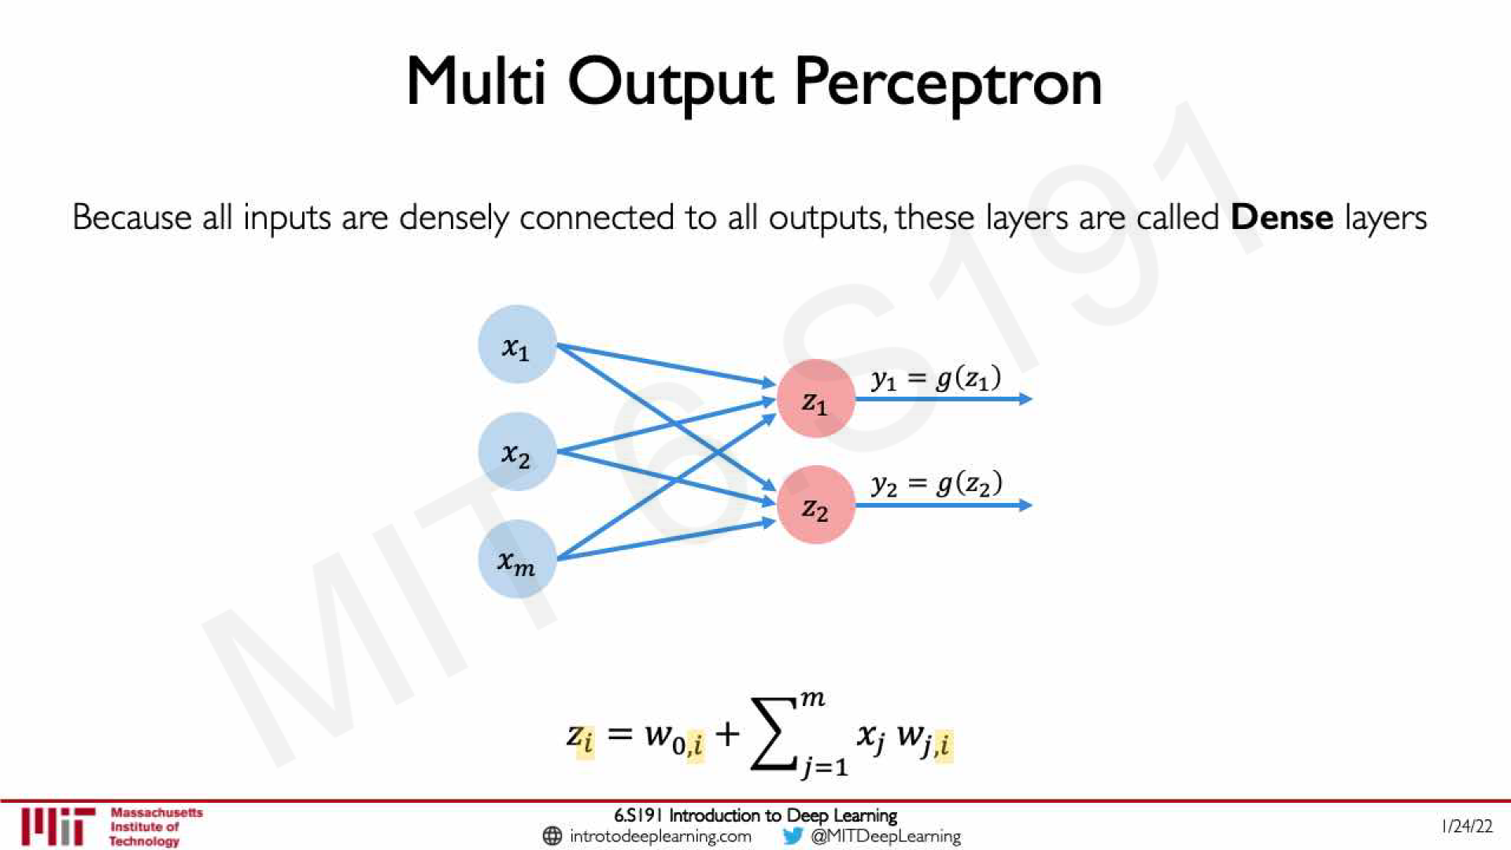

Slide 35
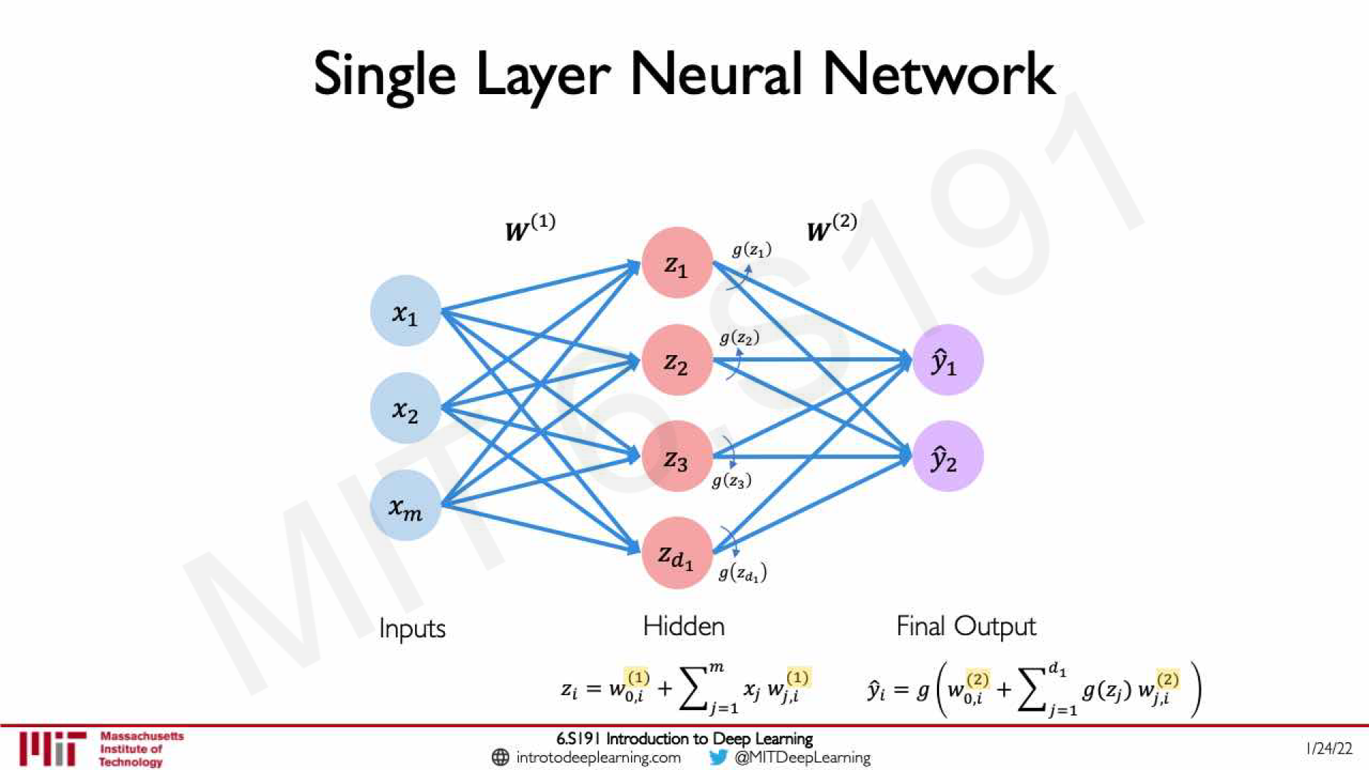

Slide 36
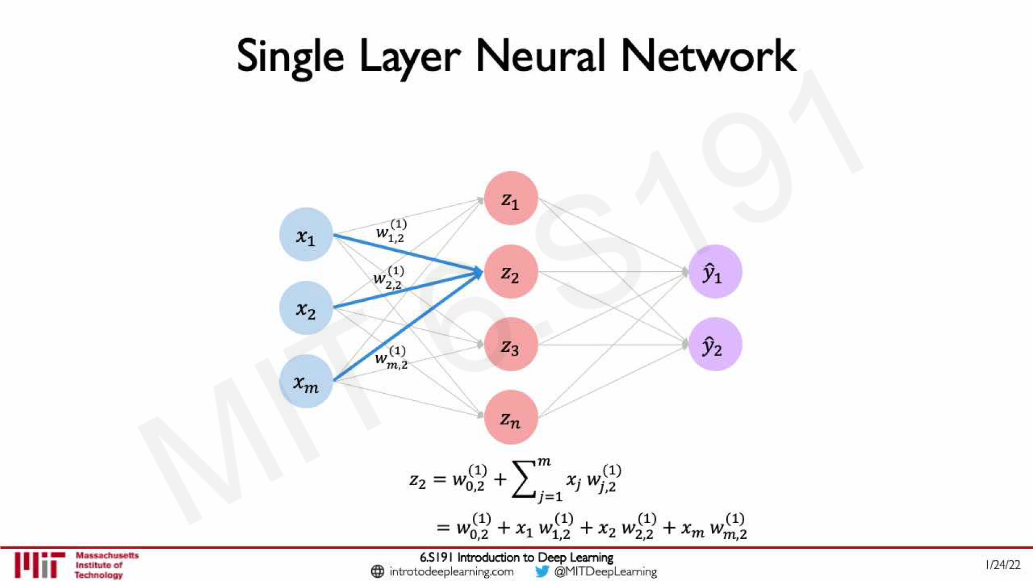

Slide 37
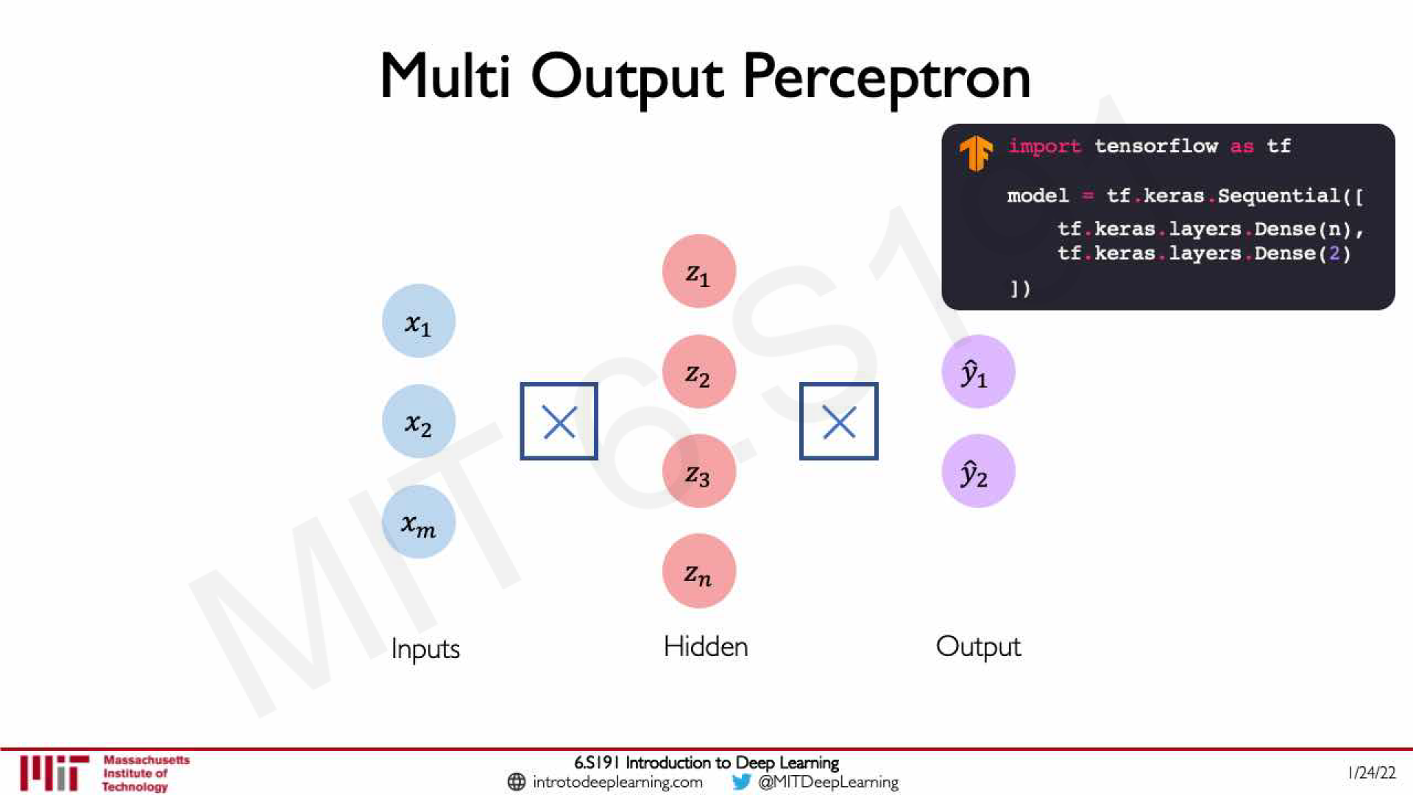

Slide 38
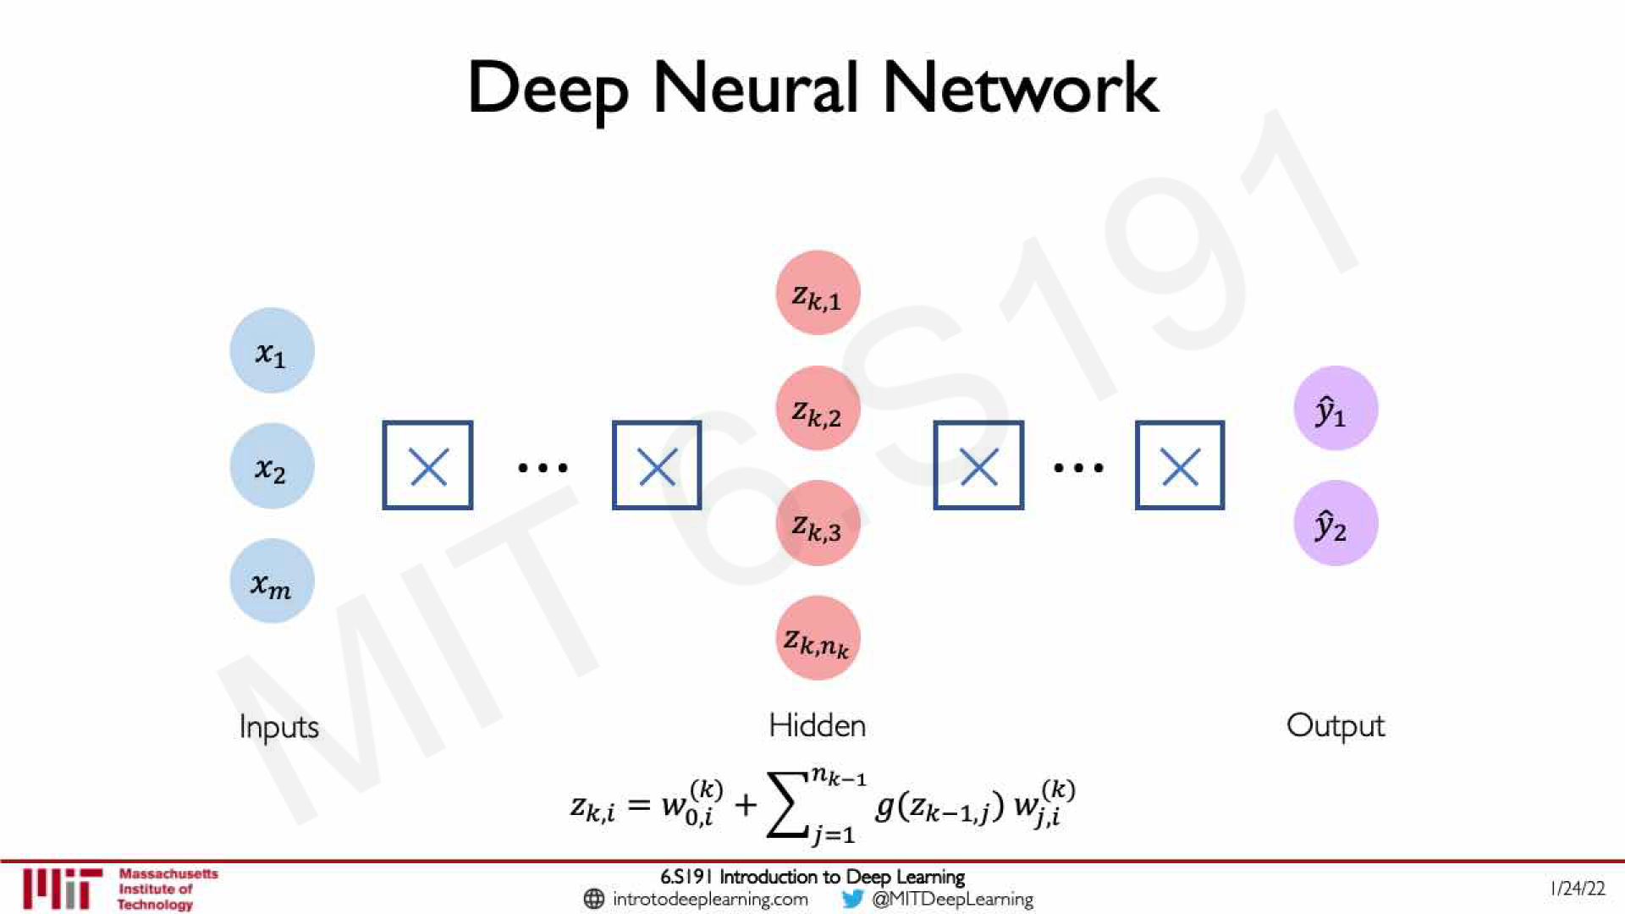

Slide 39
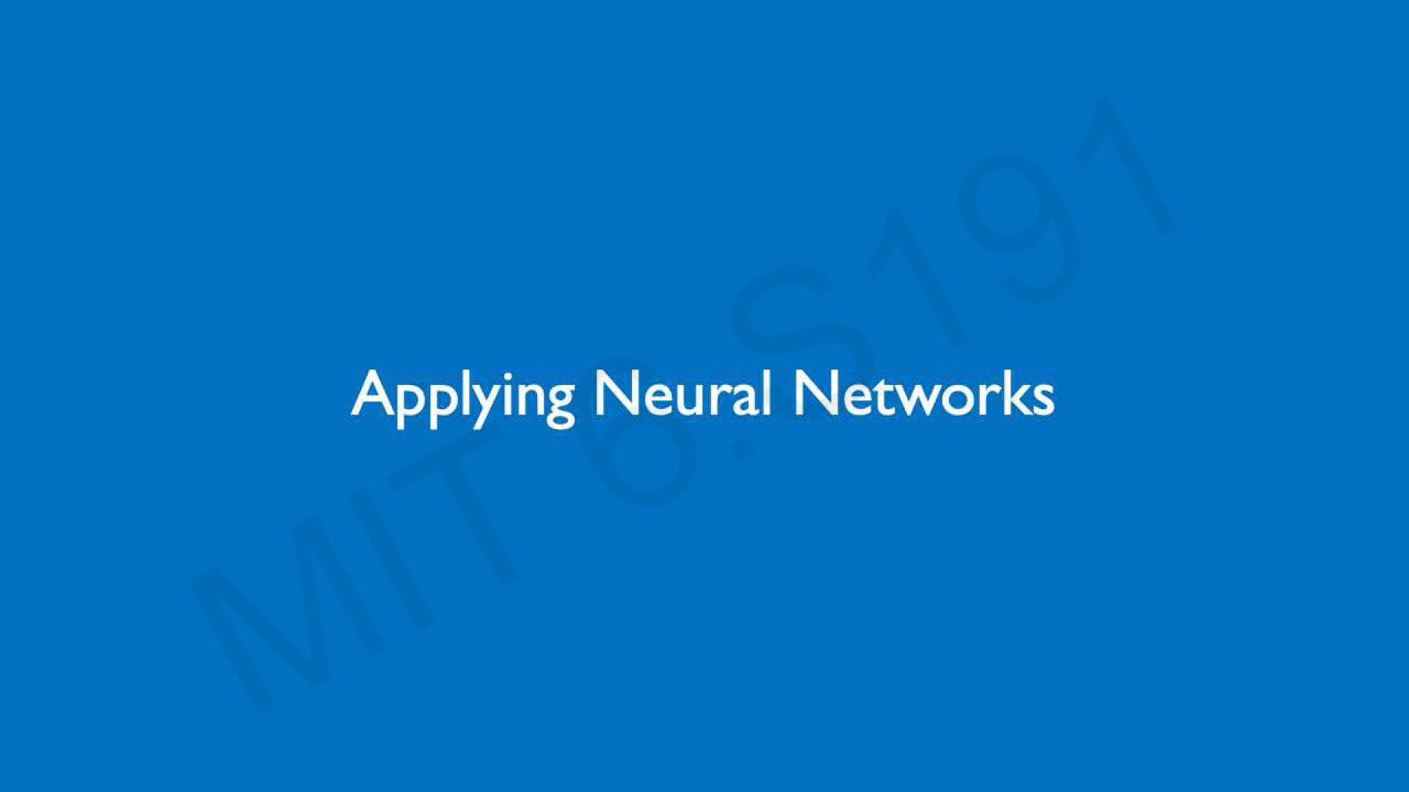

Slide 40
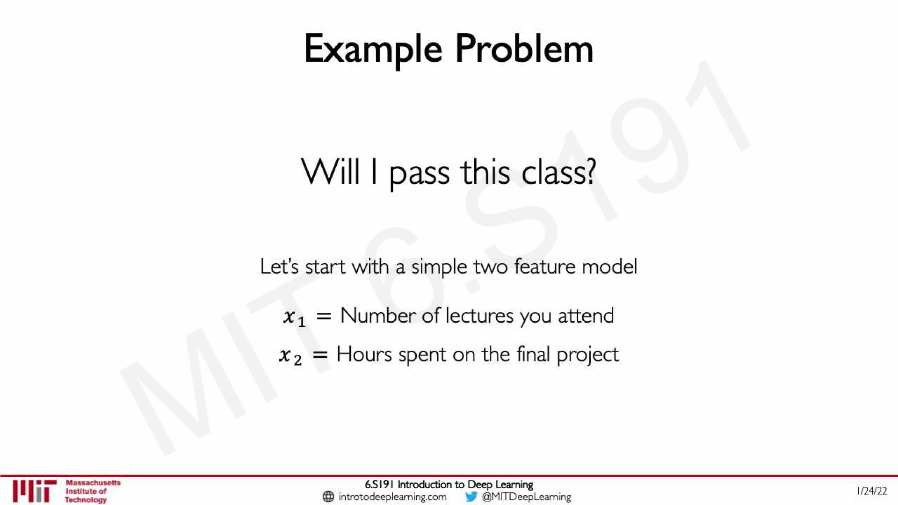

Slide 41
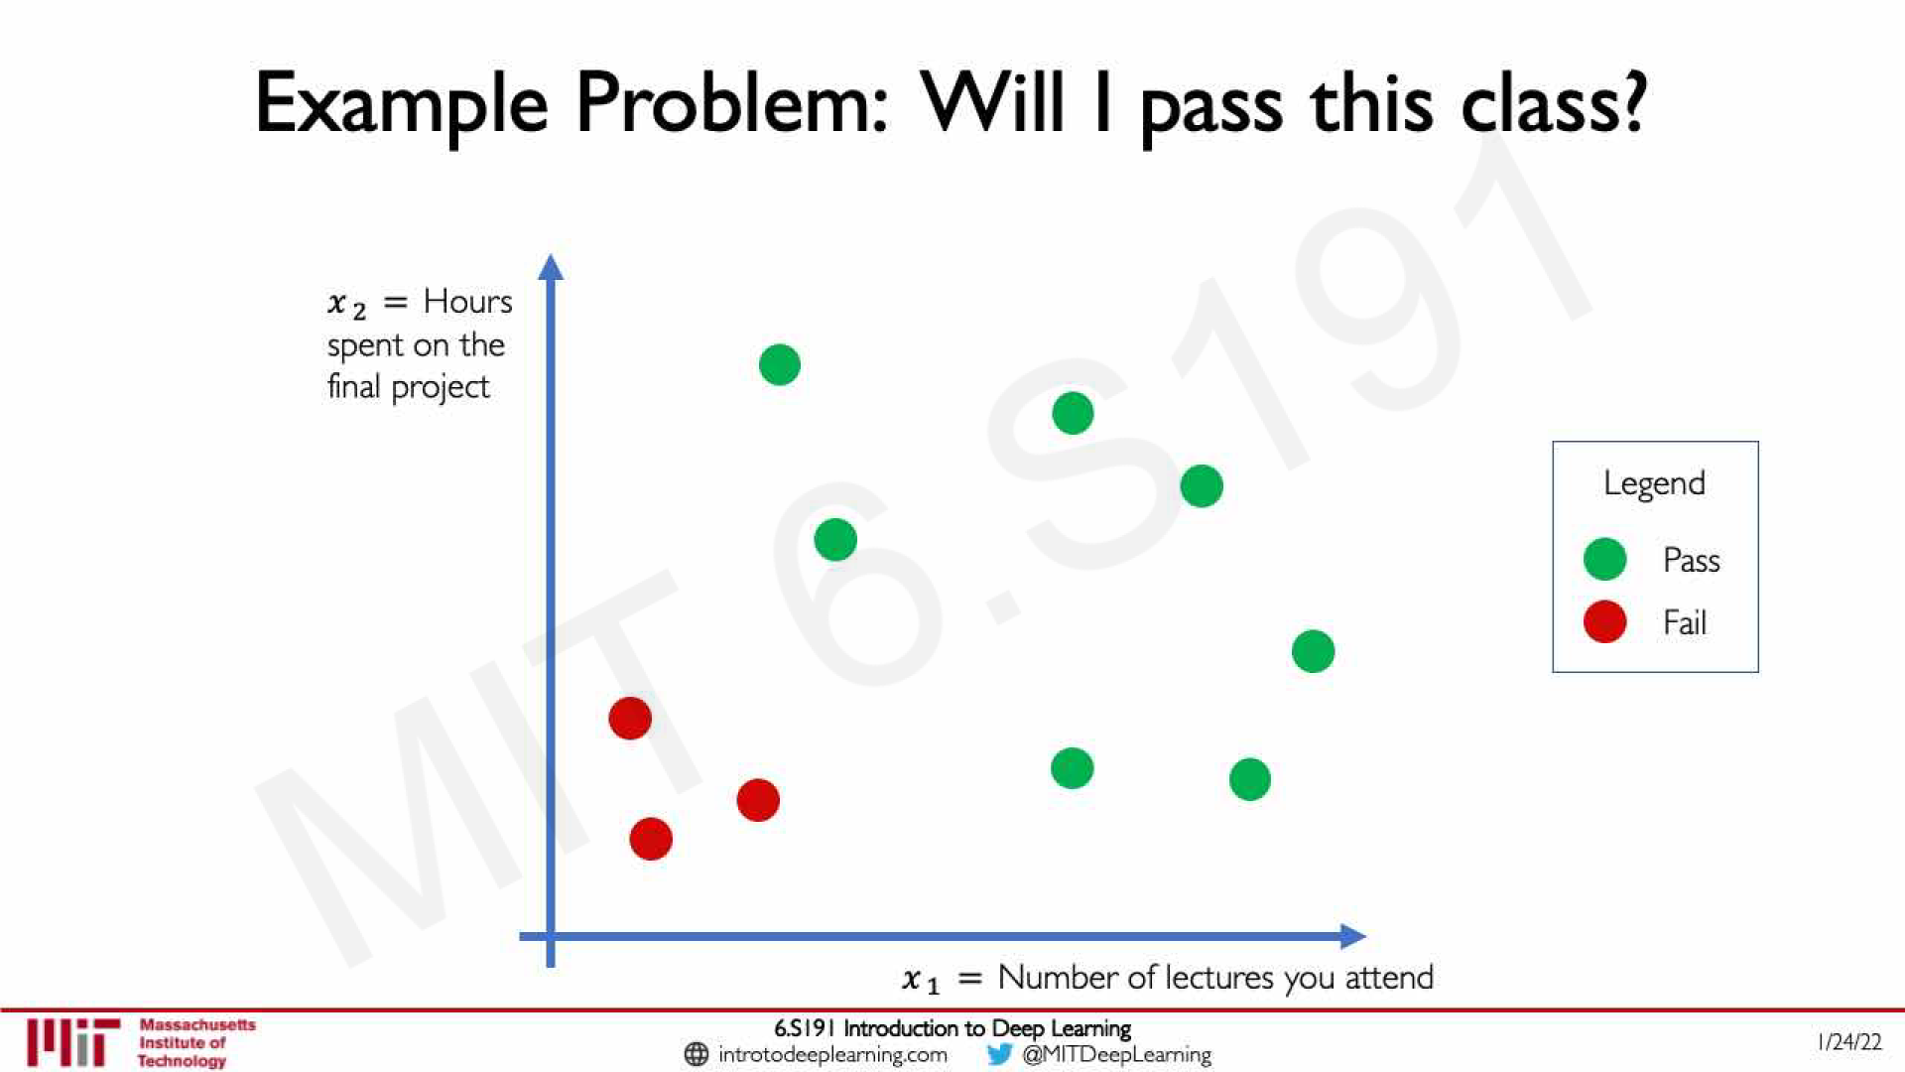

Slide 42
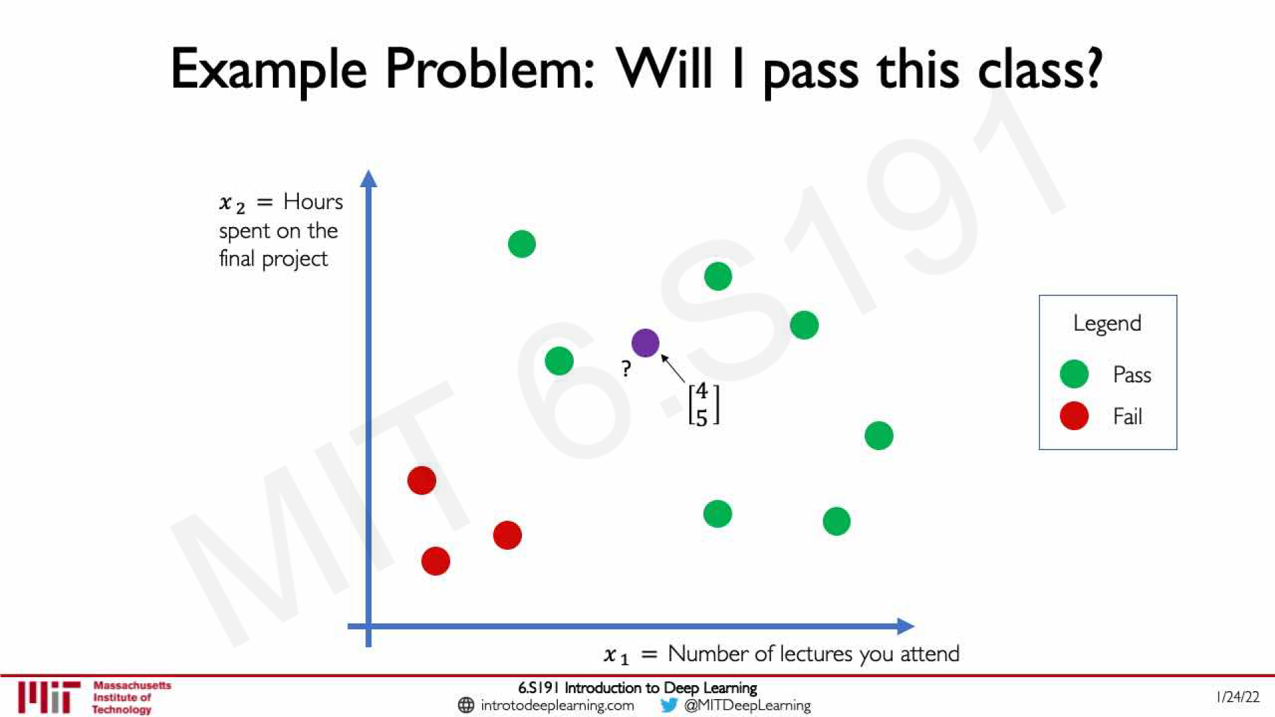

Slide 43
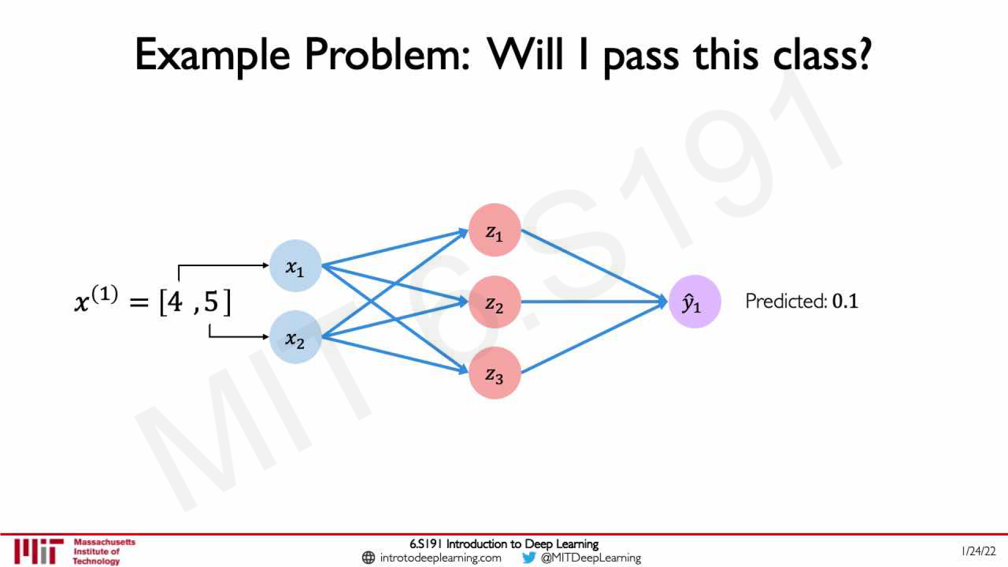

Slide 44
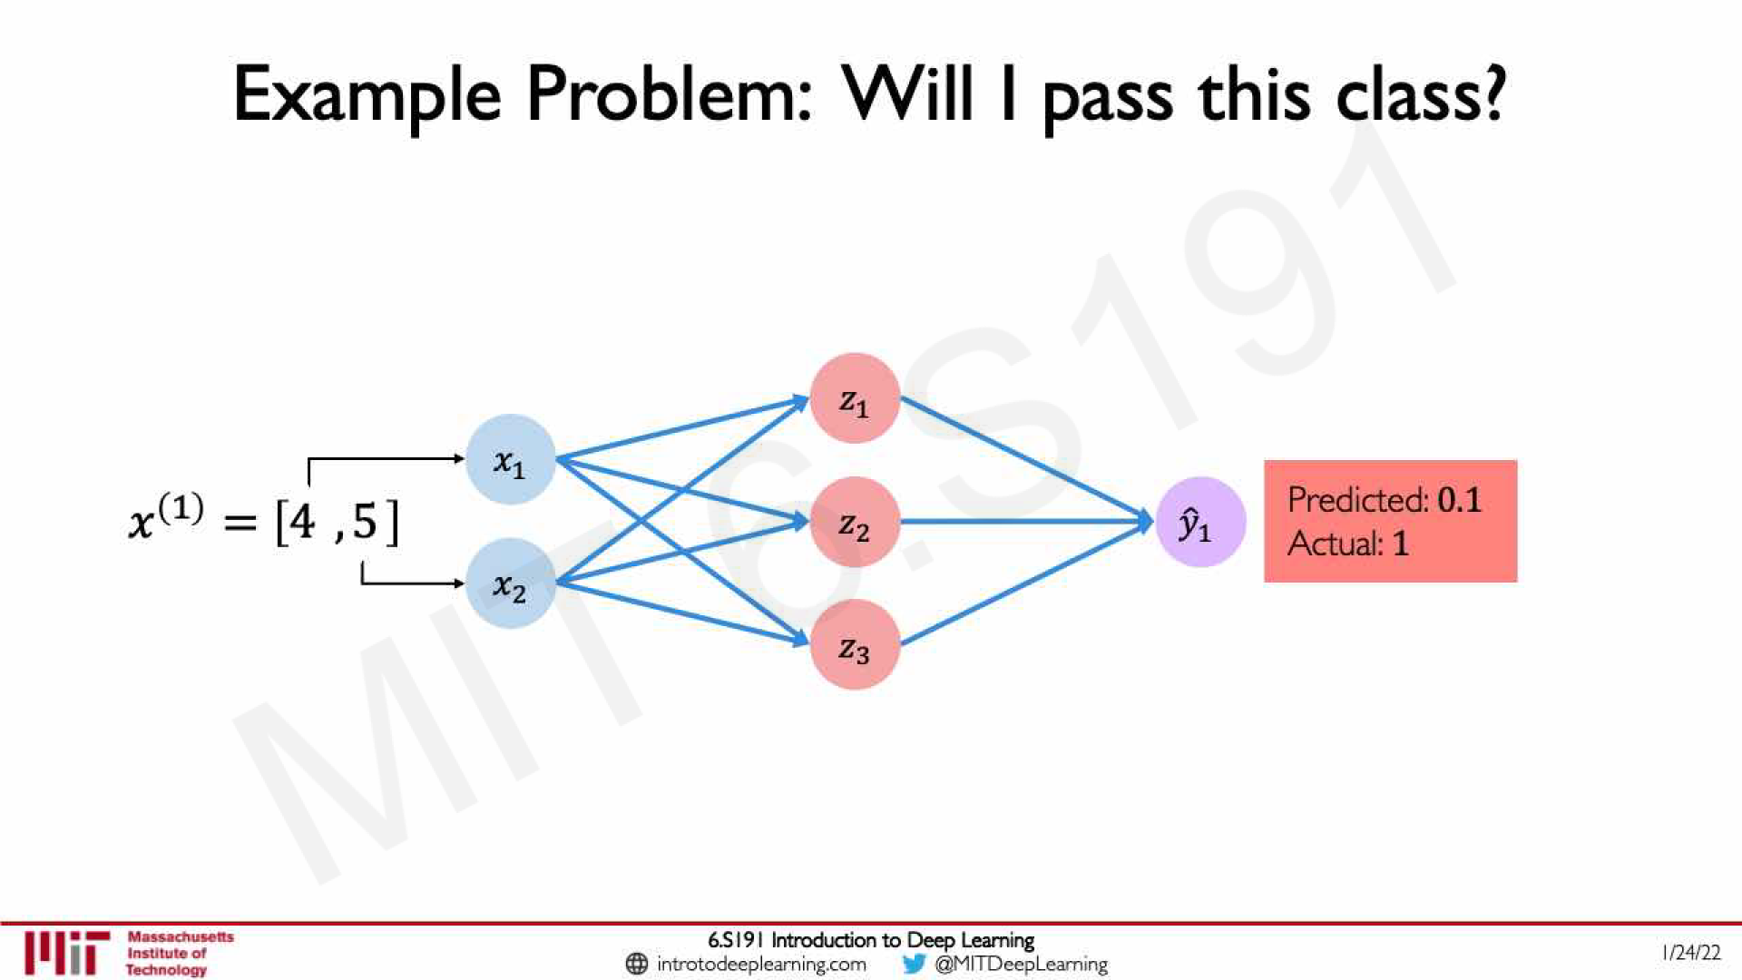

Slide 45
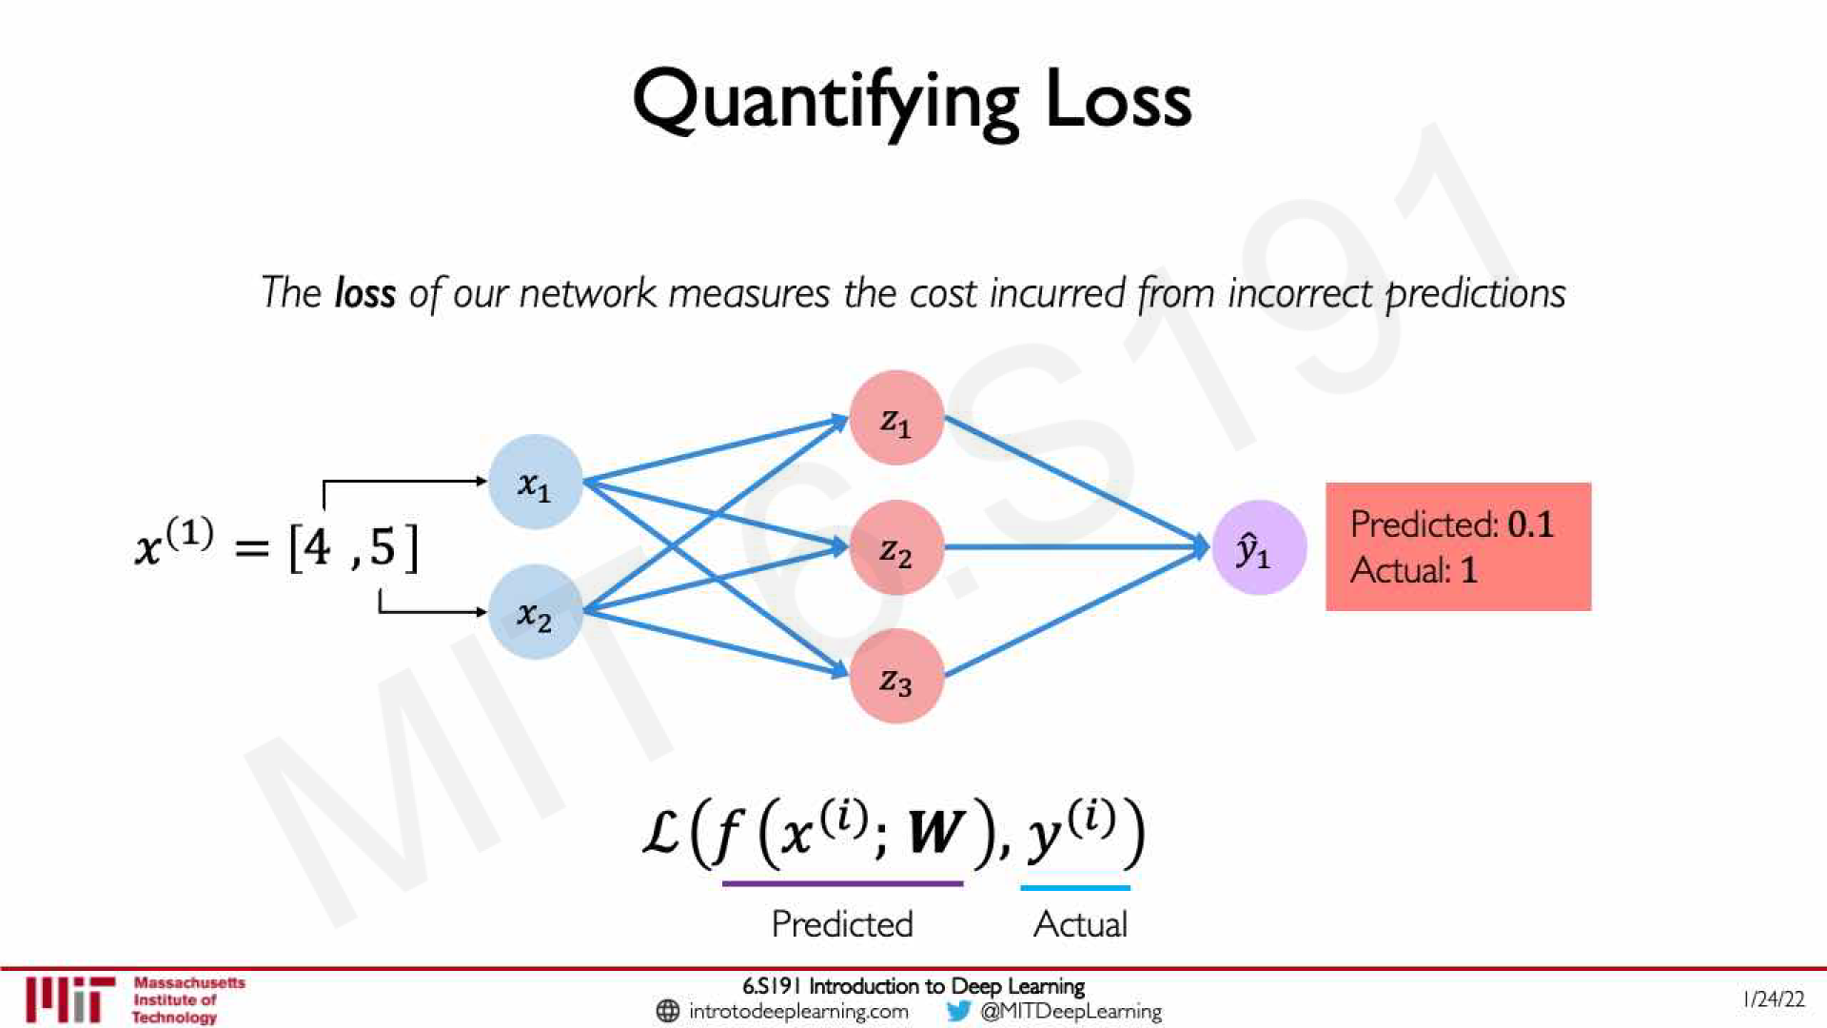

Slide 46
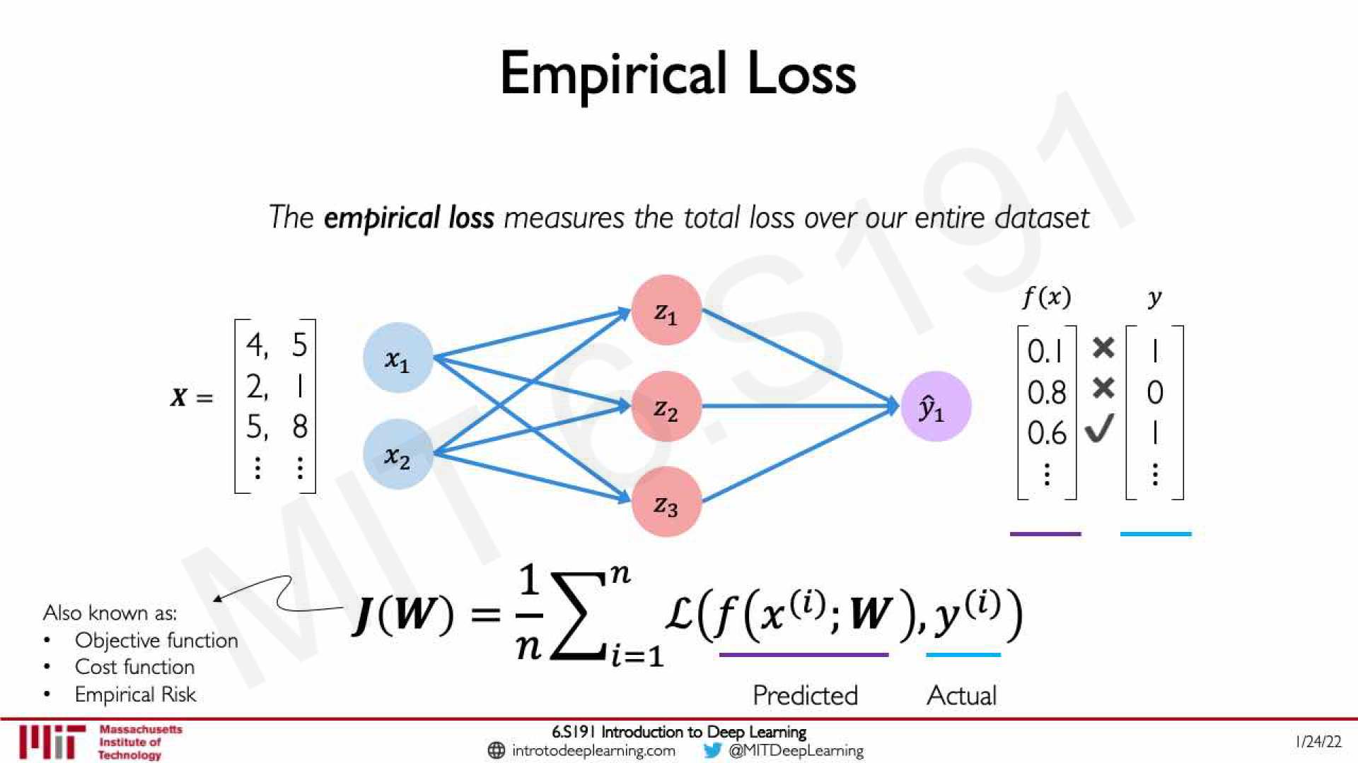

Slide 47
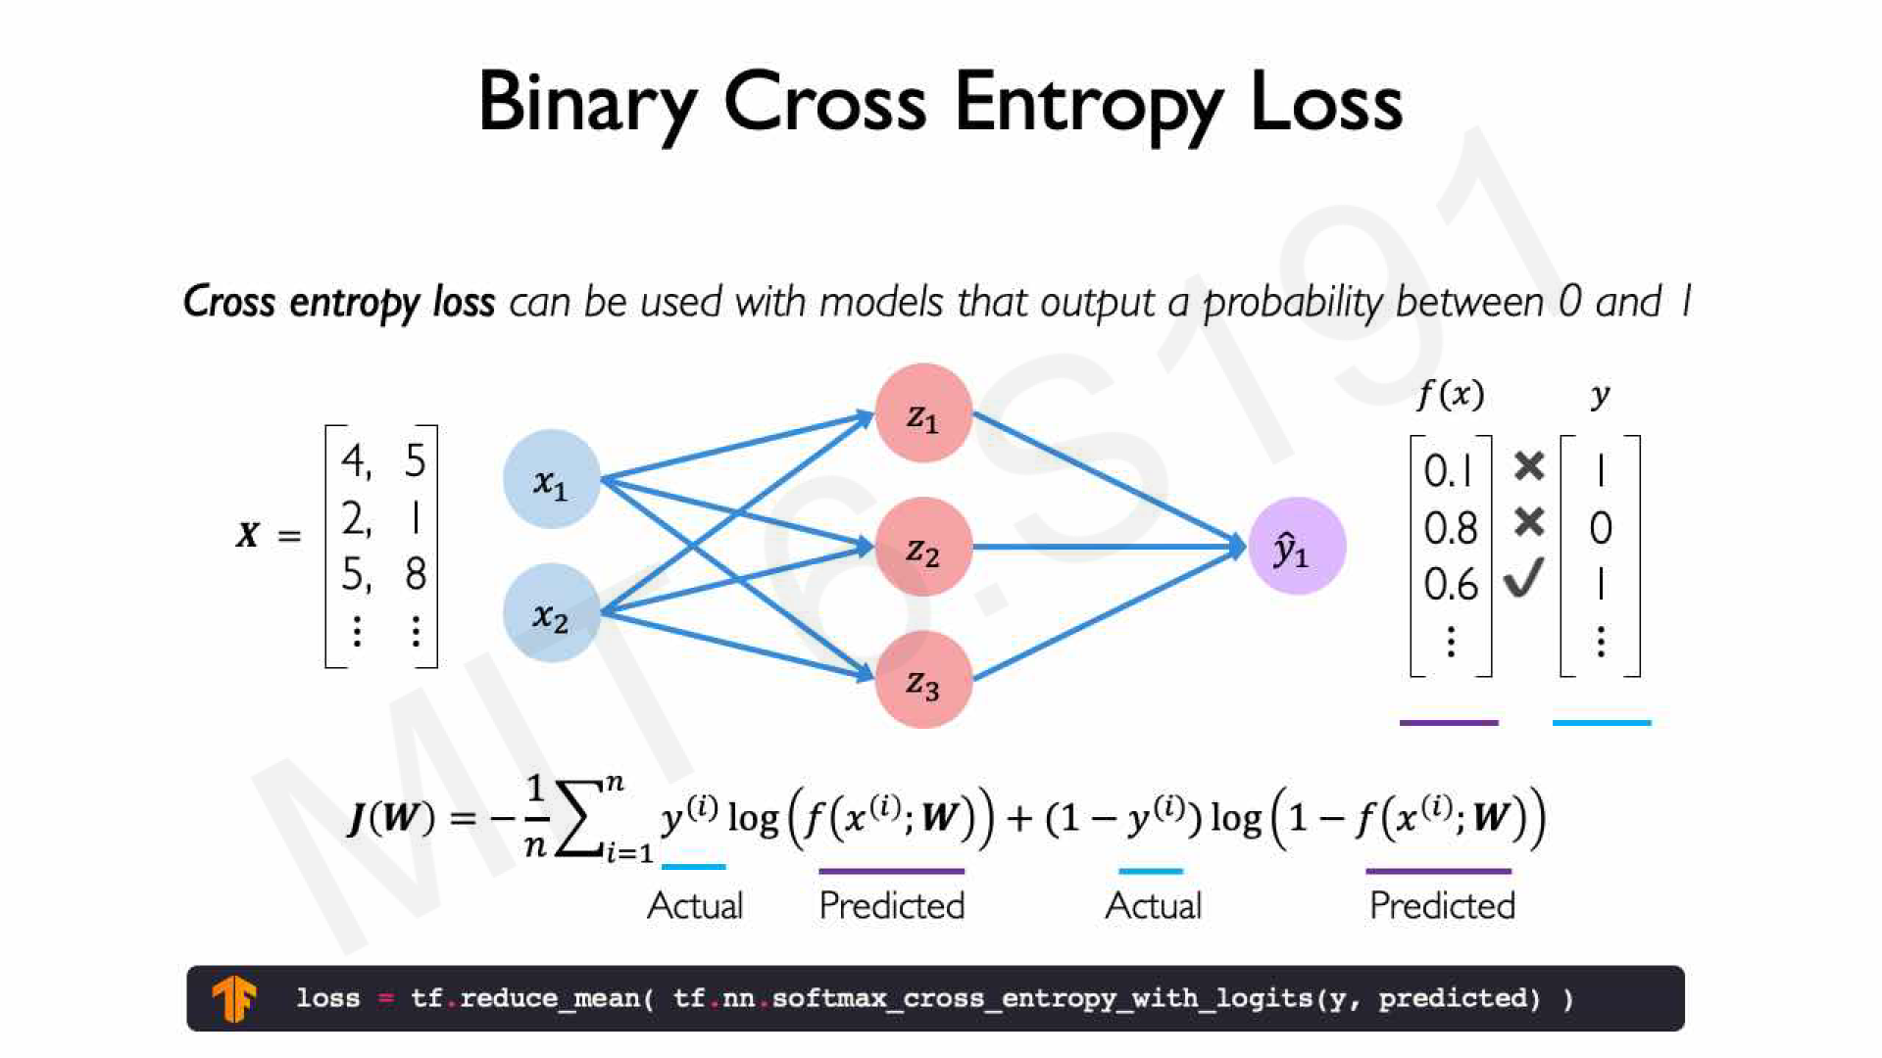

Slide 48
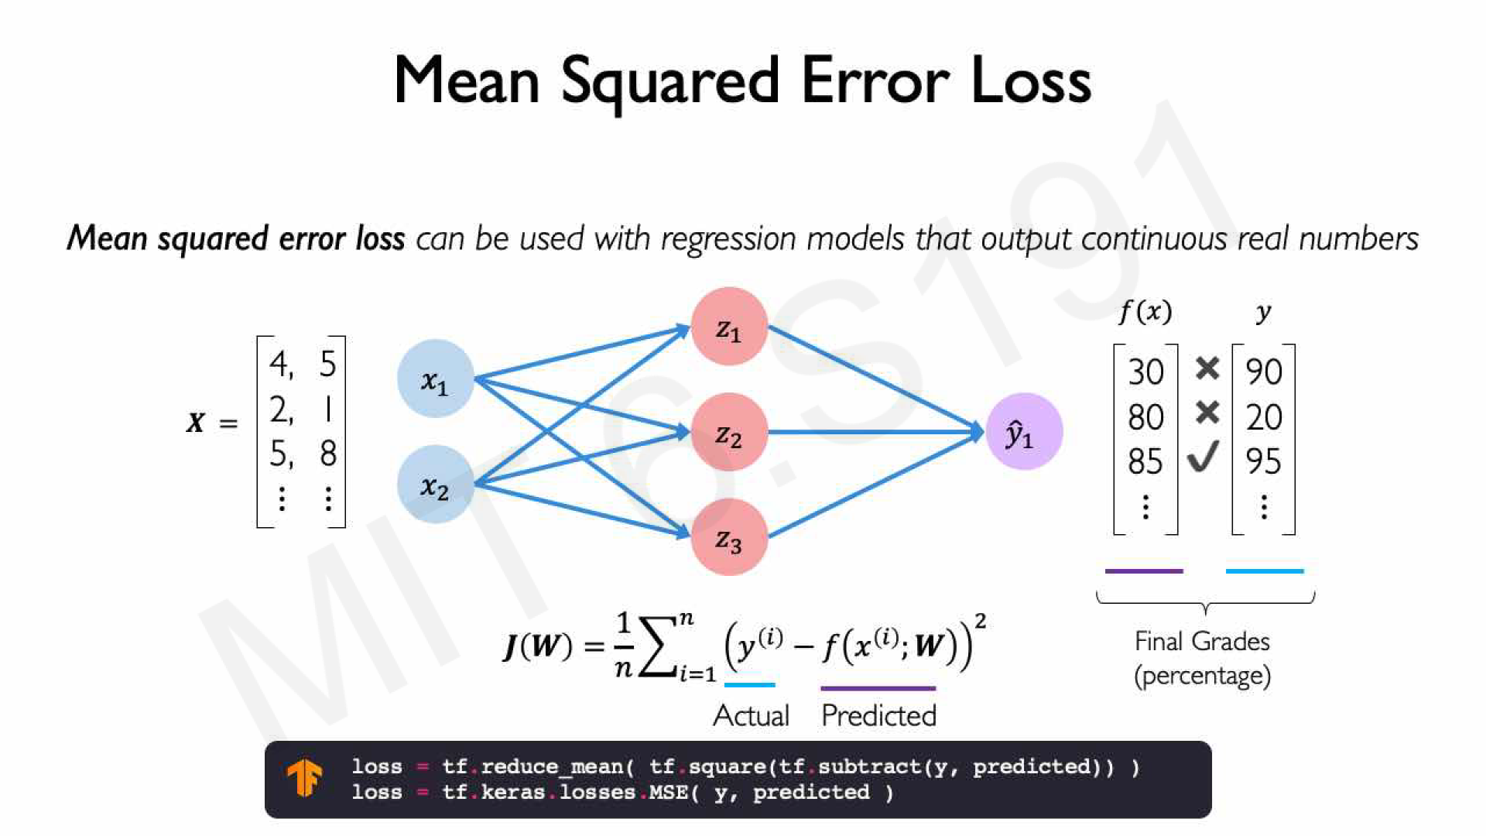

Slide 49
The Backpropagation Algorithm

Slide 50
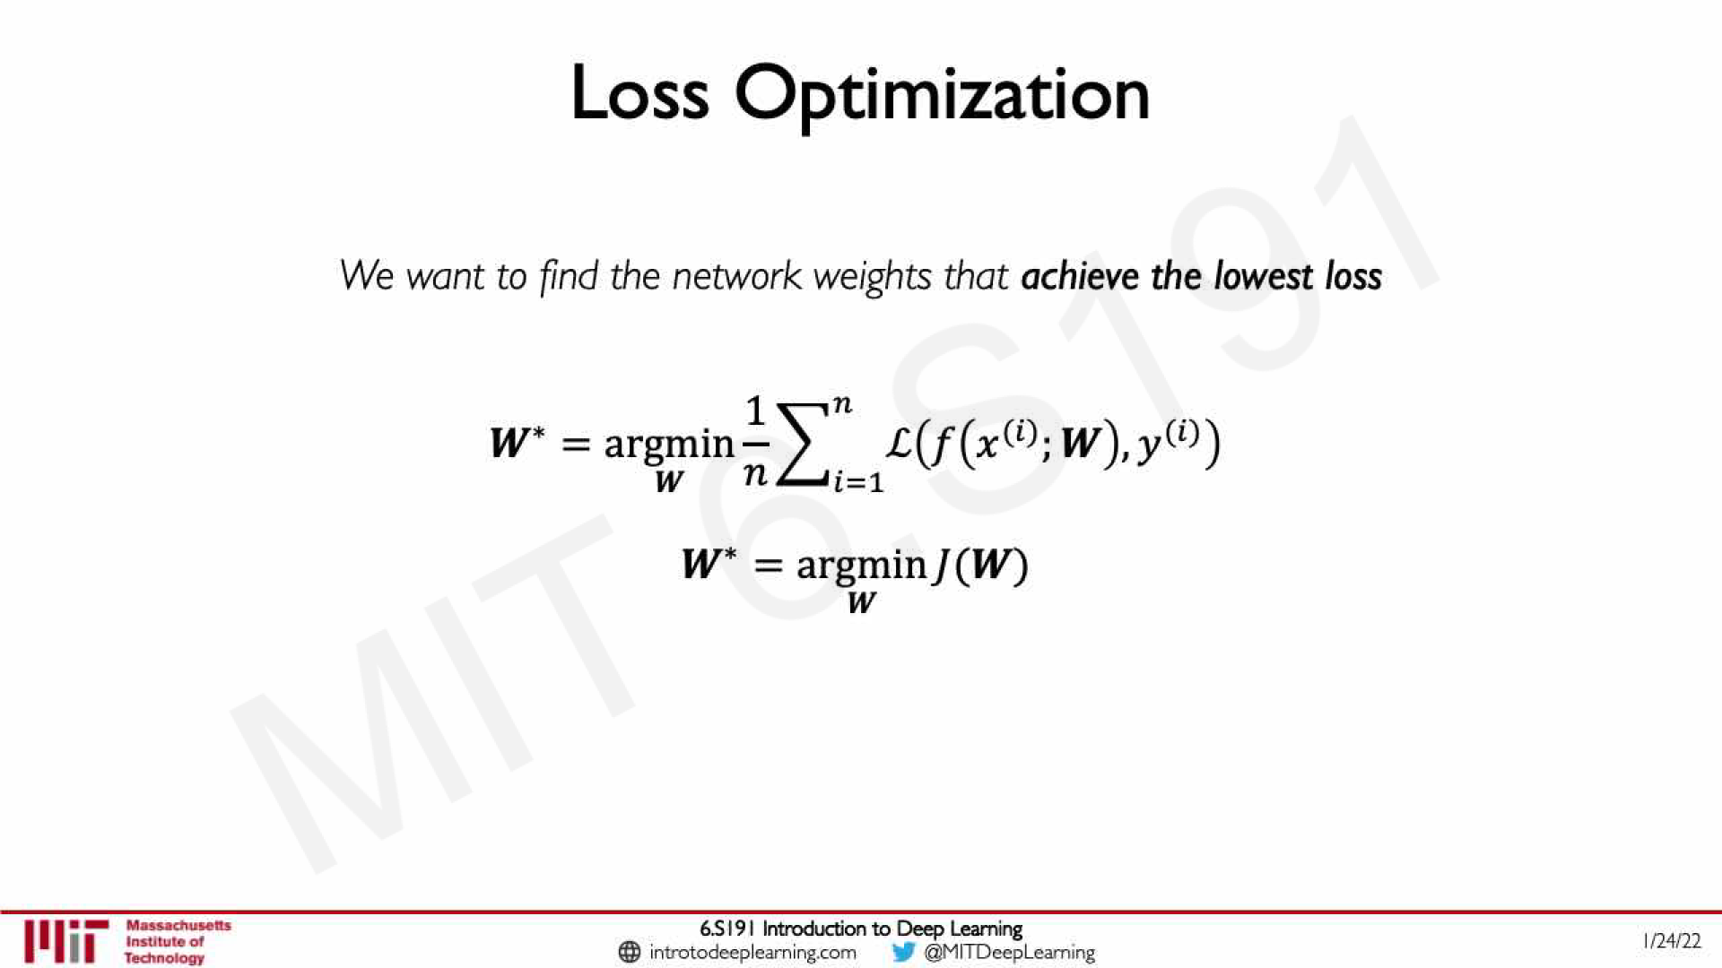

Slide 51
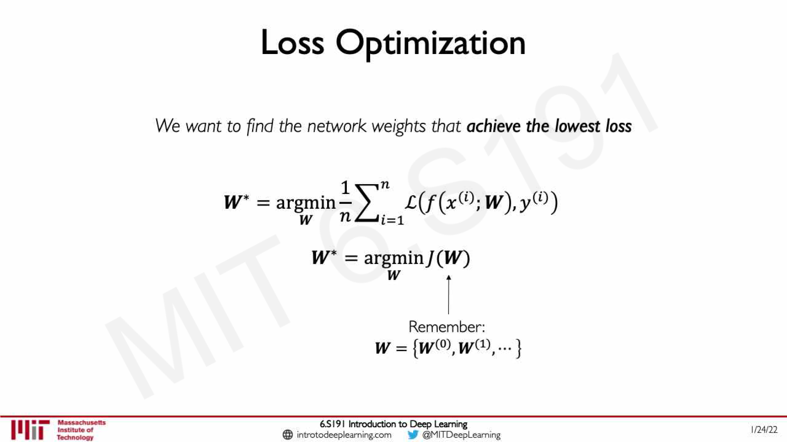

Slide 52
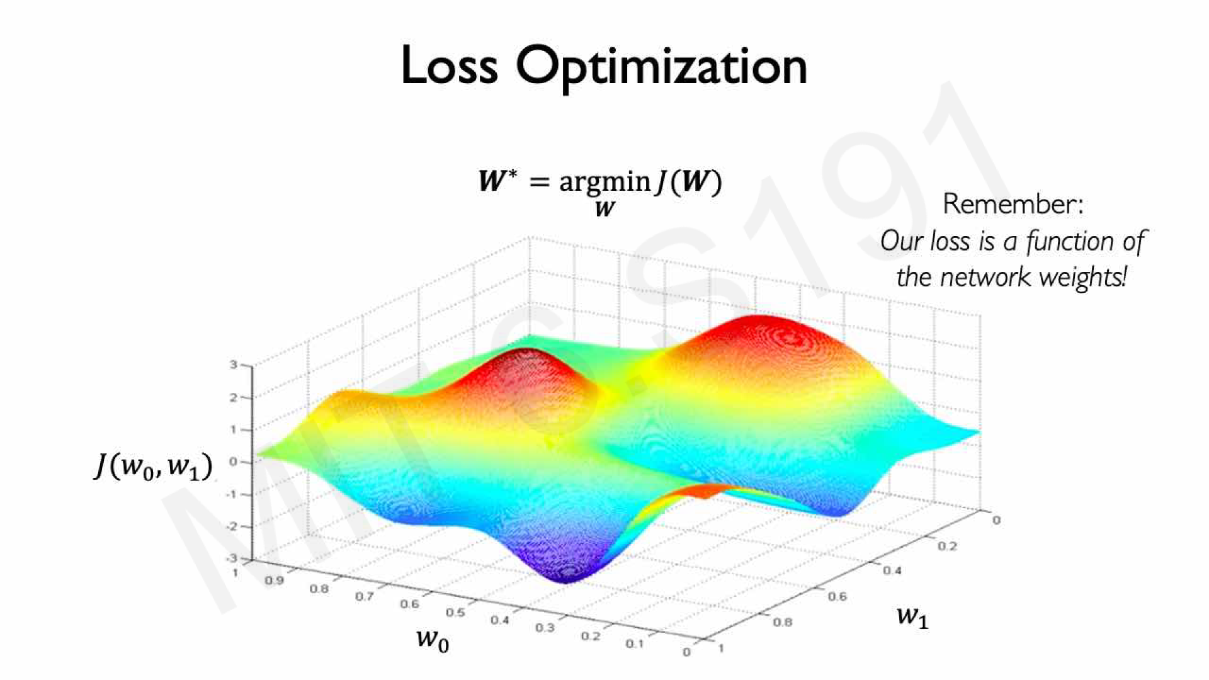

Slide 53
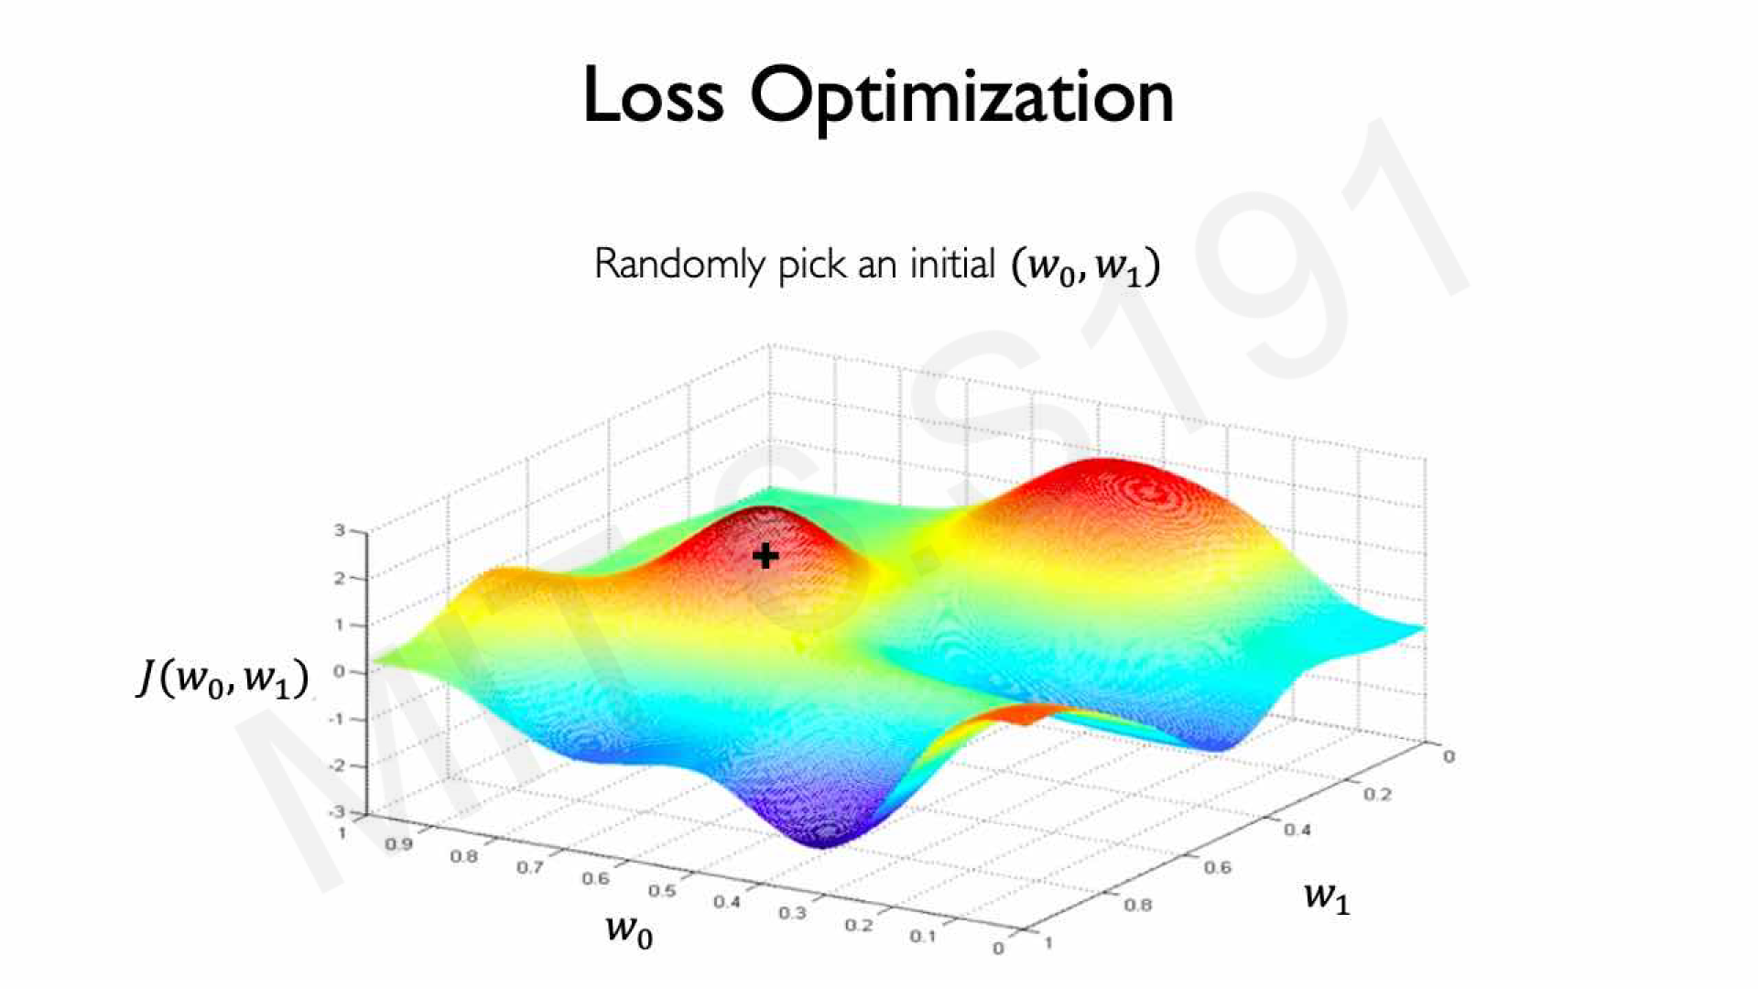

Slide 54
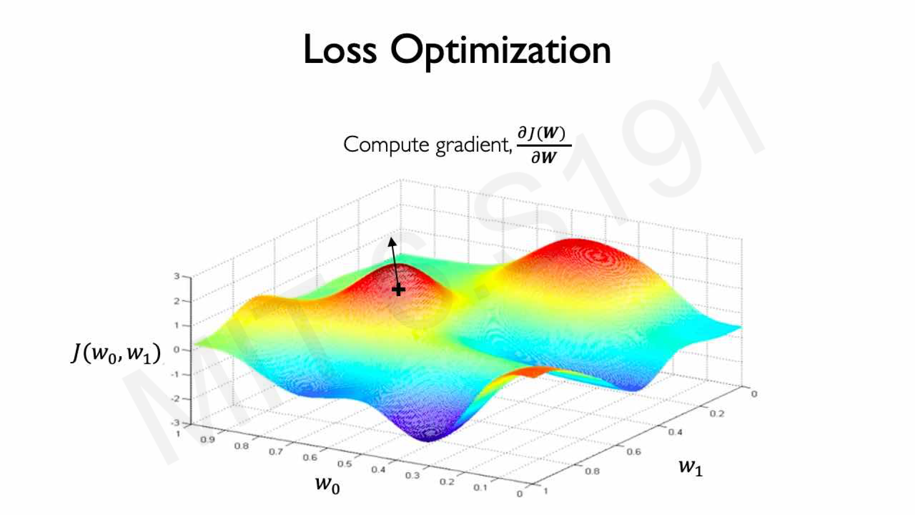

Slide 55
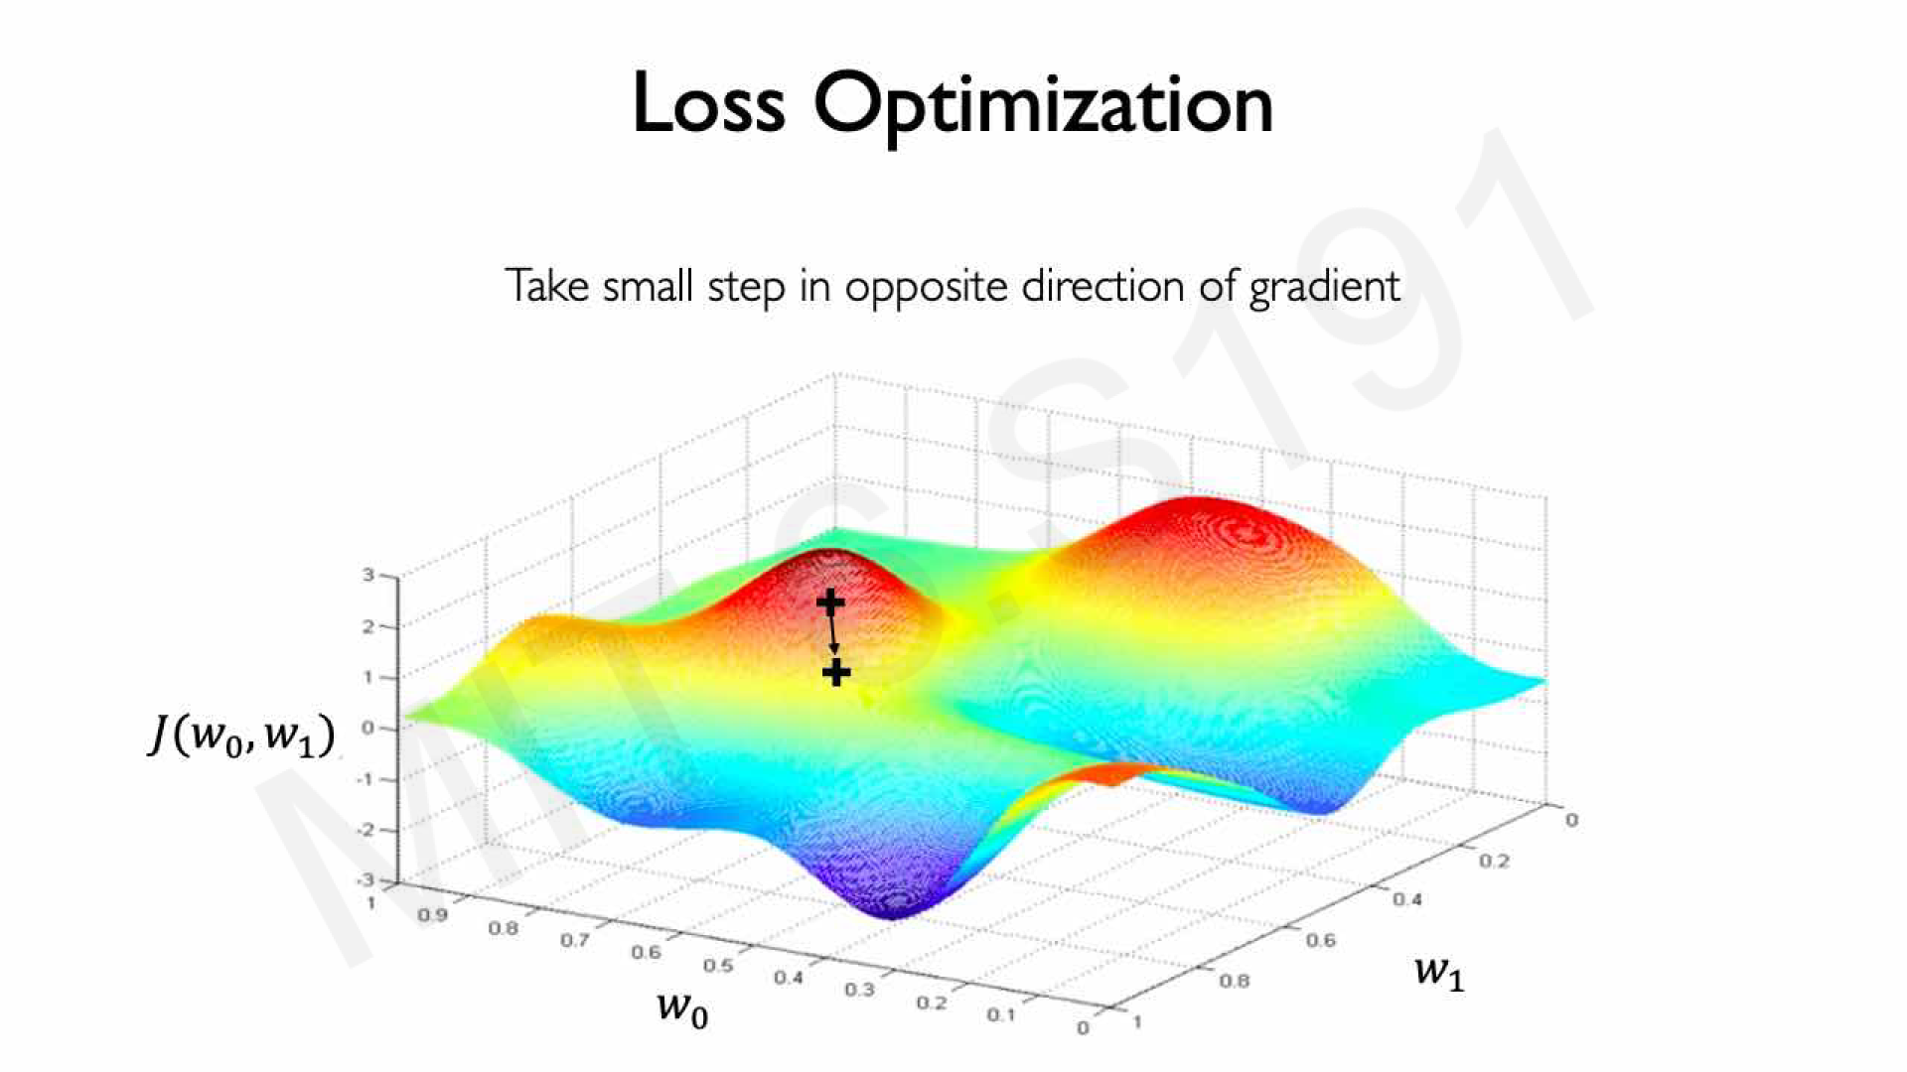

Slide 56
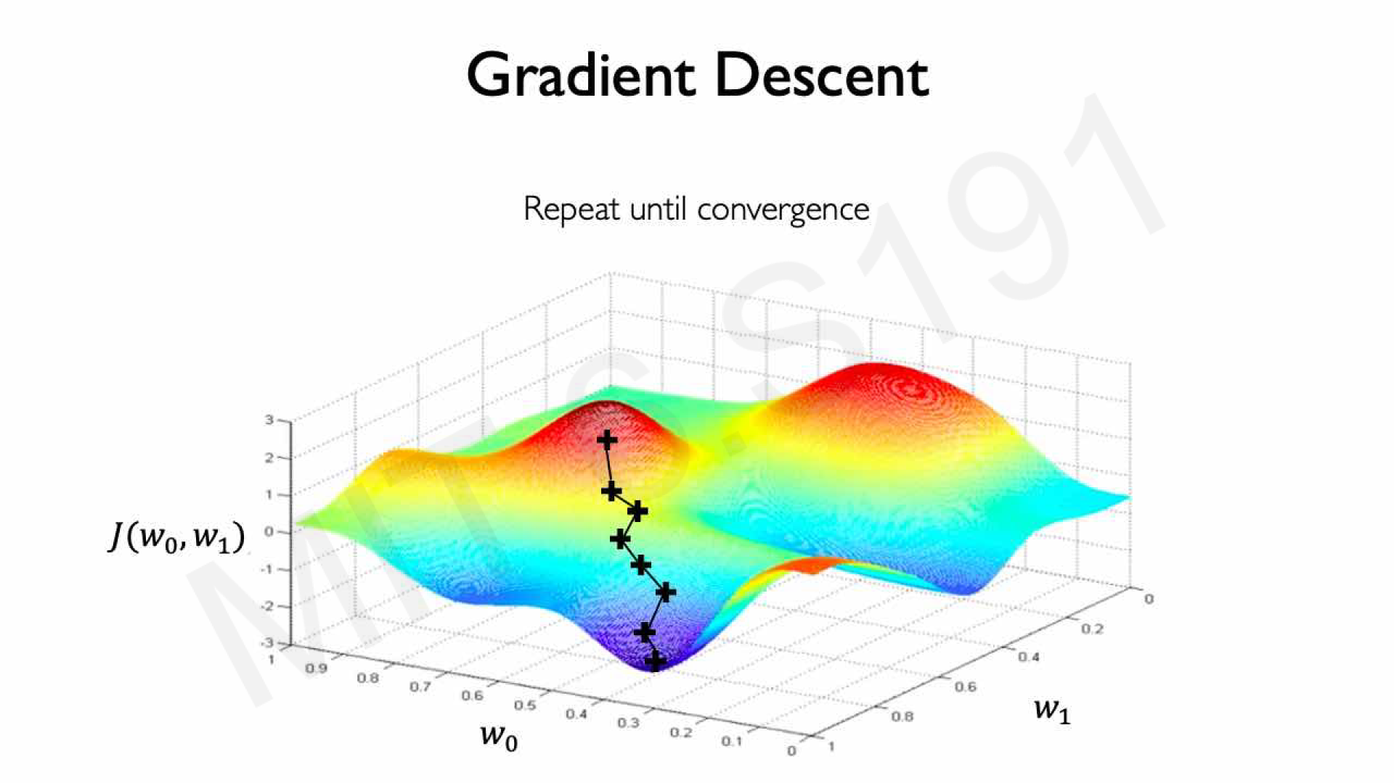

Slide 57
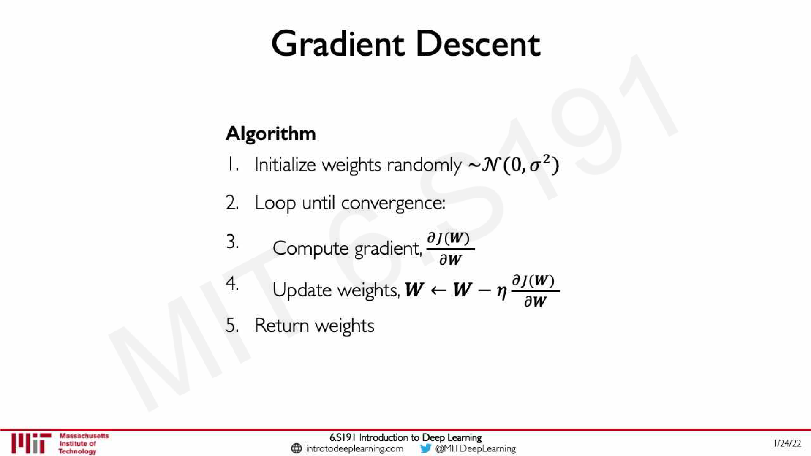

Slide 58


Slide 59


Slide 60


Slide 61


Slide 62


Slide 63


Slide 64
DNN Tips & Tricks

Slide 65


Slide 66


Slide 67


Slide 68


Slide 69


Slide 70


Slide 71


Slide 72


Slide 73


Slide 74


Slide 75


Slide 76


Slide 77


Slide 78


Slide 79


Slide 80


Slide 81


Slide 82


Slide 83


Slide 84


Slide 85


Slide 86


Slide 87


Slide 88


Slide 89


Slide 90


Slide 91


Slide 92


Slide 93


Slide 94


Slide 95


Slide 96


Slide 97


Slide 98


Slide 99
Why Deep

Slide 100
Why deep, comparatively
DL
ML

Slide 101

Why deep, intuitively
Intuitively, depth exponentiates capacity (vs width, which grows polynomially)
(Width remains important! It sets the “embedded dimension”)
Depth is great, but adds structure (or constraints, or symmetries):

Slide 102
Why deep, in NLP
In NLP, everything* can be improved with DL (at least w.r.t representation)
High-dimensional input is hard to represent w/o DL
Many weird interactions in language => expressivity is key
=> ALL of our models are DL-variants (RNN, CNN, GNN, Transformers)
*Well, almost...

Slide 103
Why do we need DNNs in NLP?
“The Technion is the best [MASK] in Israel, much better than Tel Aviv University.”
Can you predict [MASK]?

Slide 104
Questions?

